Slide 1
Staffing Consolidation
Executive Overview
May 1, 2019

Slide 2
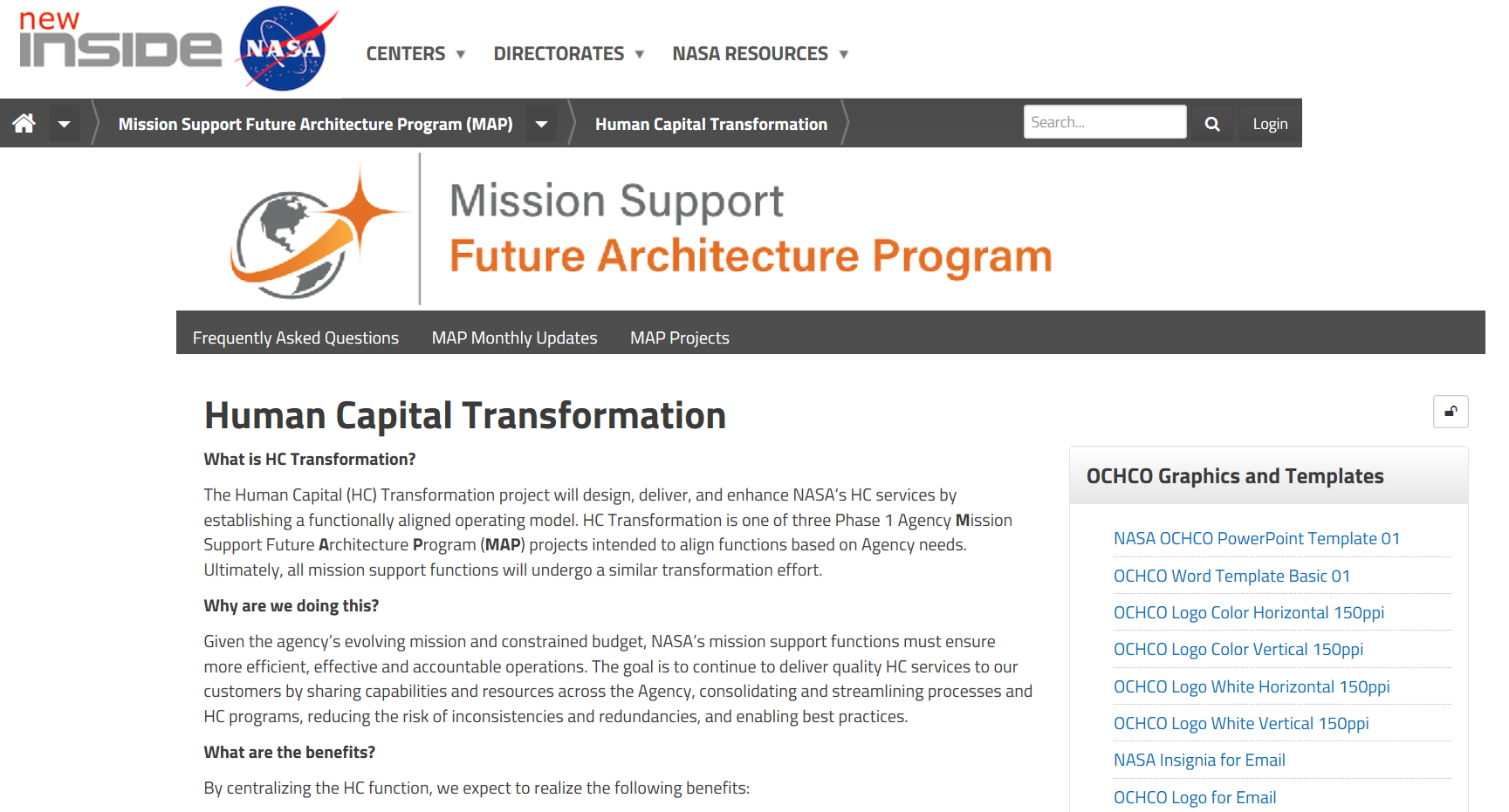
Why are we doing this?
Staffing Consolidation is a priority initiative of HC Transformation, which is a Mission Support Future Architecture Program (MAP) phase 1 project
The overarching goal of HC Transformation is to create:
greater efficiency, effectiveness, and accountability in HC mission support functions, and
greater consistency in HC service delivery
What this looks like for staffing…
More standard language in announcements
More consistent look and feel of postings
Increased opportunity for cross-center announcements
Consistent and reduced timeframes (e.g., time to fill)
Greater transparency into the status of hiring actions (i.e., Case View dashboard)
Visit the MAP HC Transformation website for more
Notes:
In 2015, the Human Capital Business Services Assessment (HC BSA) initially identified opportunities for improved service delivery in the HC function
The Business Services Steering Committee (BSC) recommended that staffing services be consolidated at the NSSC, and the Mission Support Council (MSC) approved this decision in 2016
HC Transformation, a Phase 1 project of the agency’s Mission Support Future Architecture Program (MAP), continued to focus on developing greater efficiency, effectiveness, and accountability in HC mission support functions, as well as greater consistency in HC service delivery across the agency. Staffing consolidation at NSSC continued to be a priority of this effort.
OCHCO committed to transitioning staffing services to NSSC by FY20 (approved by MSC in Aug 2018)

Slide 3
Bottom Line – What’s Happening
On May 20, 2019 staffing services will transition to the NSSC, and HR Business Partners (HRBPs) will be deployed as strategic partners
HRBPs will act as strategic partners and advisors to hiring managers
Will provide broad consulting services to include position management, recruitment strategies, hiring authorities, etc.
Will also serve as a coordinator for center practices and CBA requirements, center approvals/justifications, incentive packages, and onboarding new employees
NSSC will directly support hiring managers to fill their approved vacancies
They will work competitive hiring actions, and their support will include developing the job analysis, skills, vacancy announcement, issuing certs, and making job offers
Excludes OIG and Executive Services positions
NSSC will accomplish their staffing work through a combination of civil servants and contractors
Some current Staffing Specialists at Center HR offices will be detailed/reassigned to the NSSC to serve the whole agency but remain locally seated

Slide 4
What will hiring managers experience?
Pre-hiring Phase
Preparing the JOA
Applicant Evaluation
Candidate Selection
Security & Onboarding
Thoughts/ feelings
I need to fill this position as soon as possible!
I’m so relieved my job is finally posted
I wonder if I’ll receive the kind of candidates I’m looking for
I hope the candidate accepts our offer
My new hire is a perfect fit. I’m really satisfied with how this turned out
Hiring Manager Actions
Confirm funding availability
Discuss the position and possible recruitment strategies with HR Business Partner (HRBP)
Submit request through ServiceNow
Collaborate with NSSC Staffing Specialist to develop job analysis
Identify SMEs to contribute, if needed
Validate final skills and job announcement
Receive certificate of qualified applicants from NSSC
Work with HRBP to schedule and conduct interviews
Make selection and return certificate to NSSC
Negotiate incentives and facilitate Center approvals (with HRBP support)
Send justification and approval package to NSSC
Monitor progress of in-processing activities in ServiceNow
Prepare for employee’s EOD date and local Center onboarding activities
People involved
HRBP
NSSC Staffing Specialist
NSSC Staffing Specialist
HRBP
NSSC Staffing Specialist
HRBP
NSSC Staffing Specialist
Hiring Manager Touchpoints
Email
ServiceNow
ServiceNow
ServiceNow
ServiceNow
ServiceNow

Slide 5
What are the impacts to those involved?
 | Hiring Managers | Center HR Offices | NSSC Staffing Services Branch | Applicants/ Employees
START | Using ServiceNow to initiate all hiring and PAP actions Monitoring the status of their hiring and PAP actions and coordinating with NSSC via ServiceNow | Providing HR Business Partners (HRBPs) as strategic advisors to hiring managers Validating and/or submitting all requests for actions in ServiceNow | Providing reach back SME support on staffing regulations and policy to Center HROs Providing guidance to managers on category rating, Veterans preference, etc. Posting vacancy announcements, including development of job analysis Responding to applicant inquiries Performing qualifications and issuing certs (competitive and non-competitive hires) Making offers Acting as a liaison with Center HRO and selectee on incentives Inputting gains and publishing records in WTTS Processing ALL PAP functions in FPPS To maintain and distribute reports to Center HROs, e.g., NTE, WGI, Probationary Period
STOP | Using the RFE Portlet (HR Portal) to initiate hiring Using FPPS to initiate PAP actions Working with Center HR Specialist to complete hiring actions | Performing the staffing function and associated support (e.g., vacancy announcements, responding to inquiries, making offers) Processing all PAP actions in FPPS Inputting gains and publishing records in WTTS
CONTINUE | Obtaining authorization to fill positions at their Center To receive advice and consultation from Center HRO about recruitment strategies To provide information for job analysis (including skills) and vacancy announcement To manage the interview process To provide information for justifications To provide organizational orientation for new employees | To provide recruitment strategies and advice to hiring managers To manage and administer Pathways program, IPAs, Volunteer Interns Program, and Details To write justifications and gain approval for incentives, NEX, Fellows and other appointments requiring approval To act as Selective Placement Coordinator and Veteran Program Manager To ensure all CBA and local practices are followed To conduct onsite orientation |  | To apply for positions through USA Jobs To direct questions about vacancy announcements (VA) to the contact listed in the VA To provide onboarding/in-processing information to NSSC Caseworker To coordinate with their local Center HRO for orientation
 |  |  | To conduct in-processing/onboarding process
Notes:
The manager, applicant, and employee experience will not significantly change. Rather, in some cases, who they work with / contact for support will change.
With standardized processes and the use of ServiceNow to manage workflows, we hope that hiring managers will experience a more transparent, efficient hiring process.

Slide 6
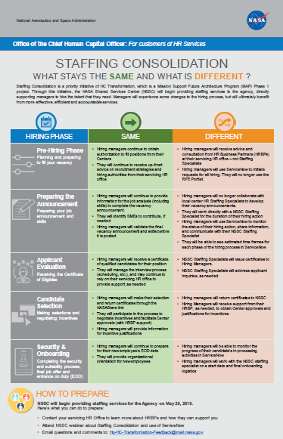
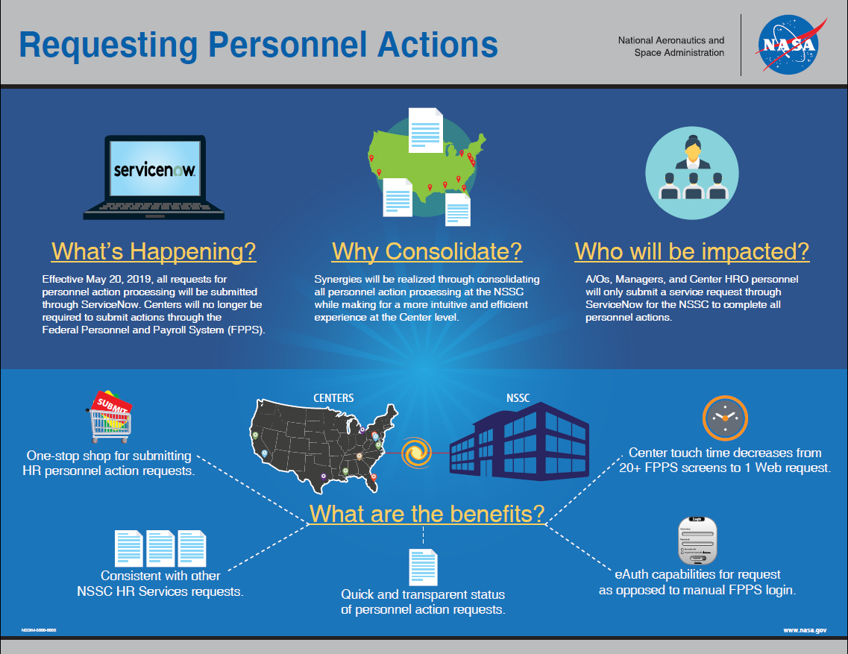
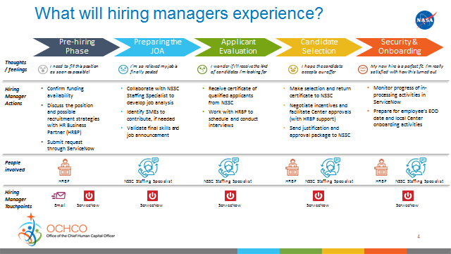
Communication & Outreach Resources Check out these resources to learn more about Staffing Consolidation
Executive Overview Brief
Infographics
NSSC Staffing Services Website
Files available now!
Files available now!
Coming Soon!
FAQs
Staffing Services Service Delivery Guide
Staffing Consolidation and ServiceNow training webinars

Slide 7
QUESTIONS AND CONCERNS. Please reach out to the following POCs if you have any questions, concerns or requests regarding this transition.
Ann Richmond
Staffing Policy Lead
NSSC Human Resources Division
Ann.E.Richmond@nasa.gov
202-358-1981
Ashley Speed
Staffing Services Branch Chief
NSSC Human Resources Division
Ashley.h.speed@nasa.gov
228-813-6094
HC Transformation Inbox
Not-for-attribution email for all HC Transformation-related inquiries (including staffing consolidation)
hq-hc-transformation-feedback@mail.nasa.gov

