Slide 1
Transition of Staffing Services
for Managers and Supervisors at GRC, GSFC, JSC, KSSC, NSSC and SSC
May 9, 2019

Slide 2
Welcome
Today we will discuss…
Staffing Consolidation overview
Hiring manager experience: journey of a staffing action
Changes to roles and responsibilities
How to start a ticket (Staffing request and PAP)
How to monitor status of actions
Given time constraints, we will not cover…
Strategic questions about staffing consolidation, organization of the staffing branch, cost of services, etc.
Please direct questions like this to your HR Director or you may send them to the HC Transformation Inbox (hq-hc-transformation-feedback@mail.nasa.gov)
IMPORTANT
For technical support please contact the NSSC at: 1-877-677-2123
Please hold questions until the end (chat will be closed during presentation)
Time for questions will be limited; remaining questions will be addressed in FAQs
Session is being recorded and will be available at a later date

Slide 3
Staffing Consolidation Overview
WHAT
WHY
WHEN
HOW
STAFFING CONSOLIDATION is a priority initiative of HC Transformation, which is a Mission Support Future Architecture Program (MAP) phase 1 project
The overarching goal is to create:
greater efficiency, effectiveness, and accountability in the staffing function; and
greater consistency in service delivery
On May 20, 2019 staffing services will transition to the NSSC. All requests for personnel action and coding will also transition
HR Business Partners at servicing HR offices will provide strategic advice to hiring managers
NSSC will directly support hiring managers to fill their approved vacancies (excludes OIG and Executive Services positions)
Some current Staffing Specialists at Center HR offices will be detailed to the NSSC to serve the whole agency but remain locally seated

Slide 4








Hiring manager experience: journey of a staffing action
Pre-hiring Phase
Preparing the JOA
Applicant Evaluation
Candidate Selection
Security & Onboarding
Thoughts/ feelings
I need to fill this position as soon as possible!
I’m so relieved my job is finally posted
I wonder if I’ll receive the kind of candidates I’m looking for
I hope the candidate accepts our offer
My new hire is a perfect fit. I’m really satisfied with how this turned out
Hiring Manager Actions
Confirm funding availability
Discuss the position and possible recruitment strategies with HR Business Partner (HRBP)
Submit request through ServiceNow
Collaborate with NSSC Staffing Specialist to develop job analysis
Identify SMEs to contribute, if needed
Validate final skills and job announcement
Receive certificate of qualified applicants from NSSC Staffing Specialist
Schedule and conduct interviews, using Center processes
Make selection and return certificate to NSSC Staffing Specialist
Partner with HRBP to consider best approach for incentives, provide justifications and obtain Center approvals
Monitor progress of in-processing activities in ServiceNow
Prepare for employee’s EOD date and local Center onboarding activities
People involved
HRBP
NSSC Staffing Specialist
NSSC Staffing Specialist
HRBP
NSSC Staffing Specialist
HRBP
NSSC Staffing Specialist
Hiring Manager Touchpoints
Email
ServiceNow
ServiceNow
ServiceNow
ServiceNow
ServiceNow
Notes:
The manager, applicant, and employee experience will not significantly change. Rather, in some cases, who they work with / contact for support will change.
With standardized processes and the use of ServiceNow to manage workflows, we hope that hiring managers will experience a more transparent, efficient hiring process.

Slide 5
Staffing Consolidation
ServiceNow and Case View

Slide 6
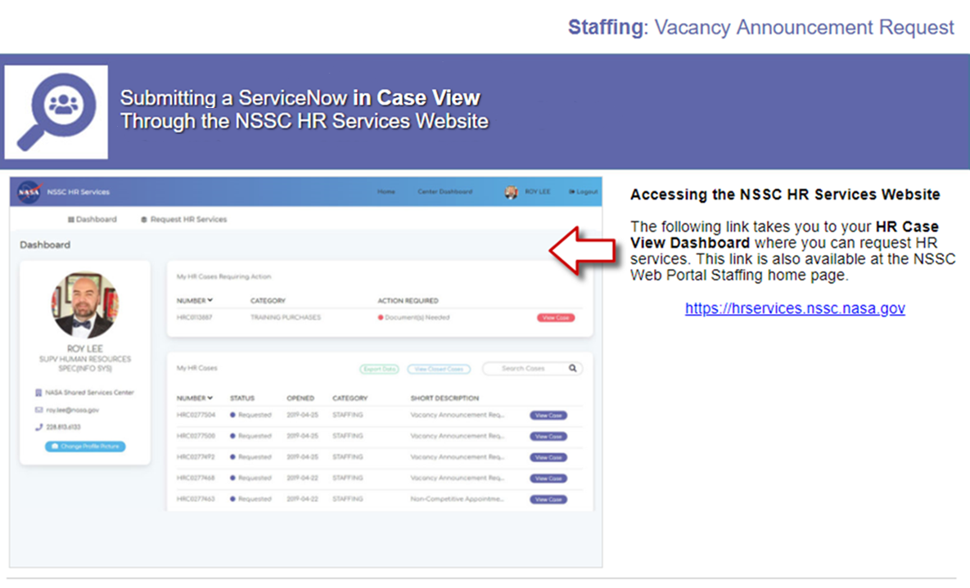

Slide 7
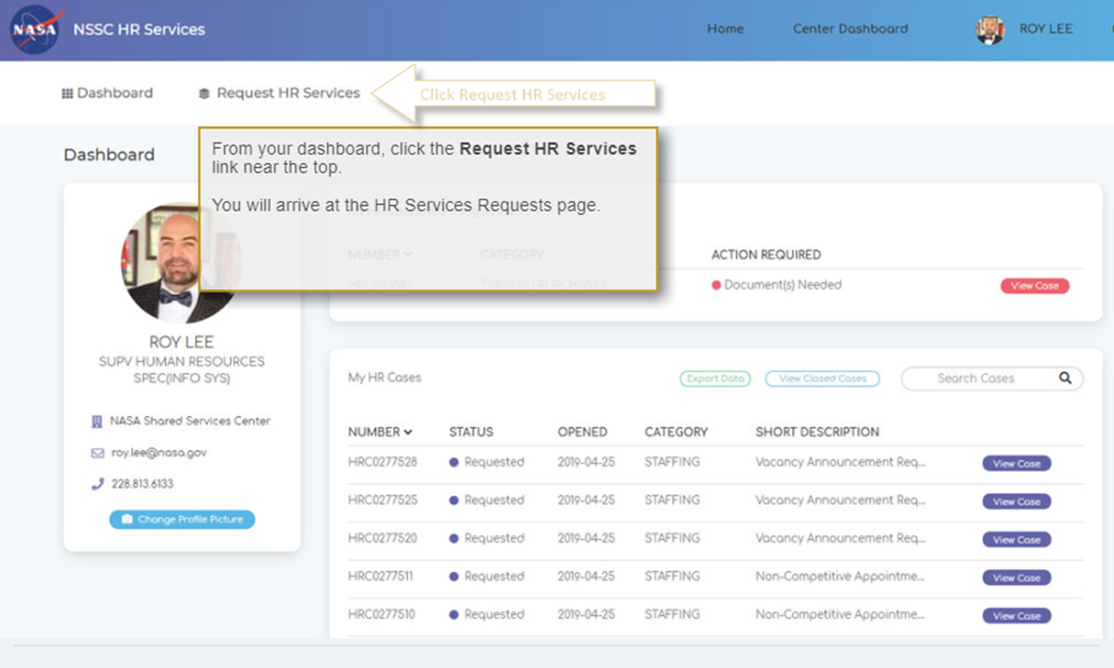

Slide 8
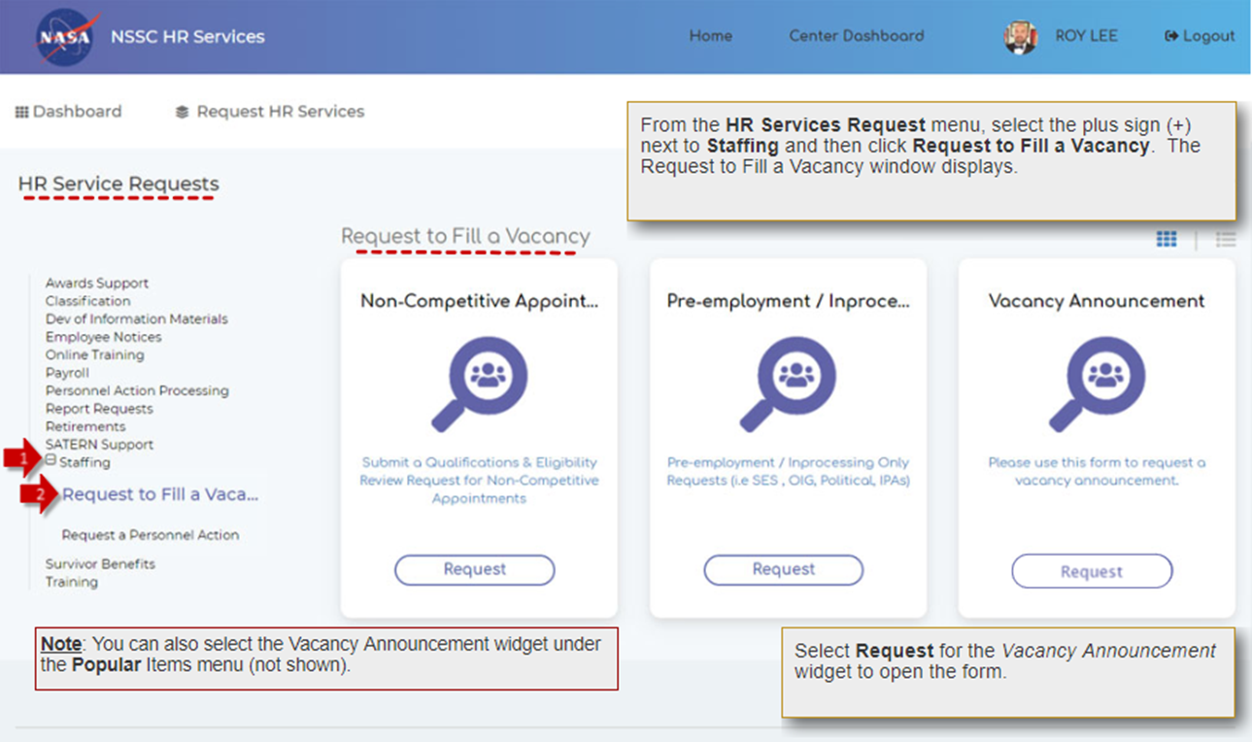
3

Slide 9
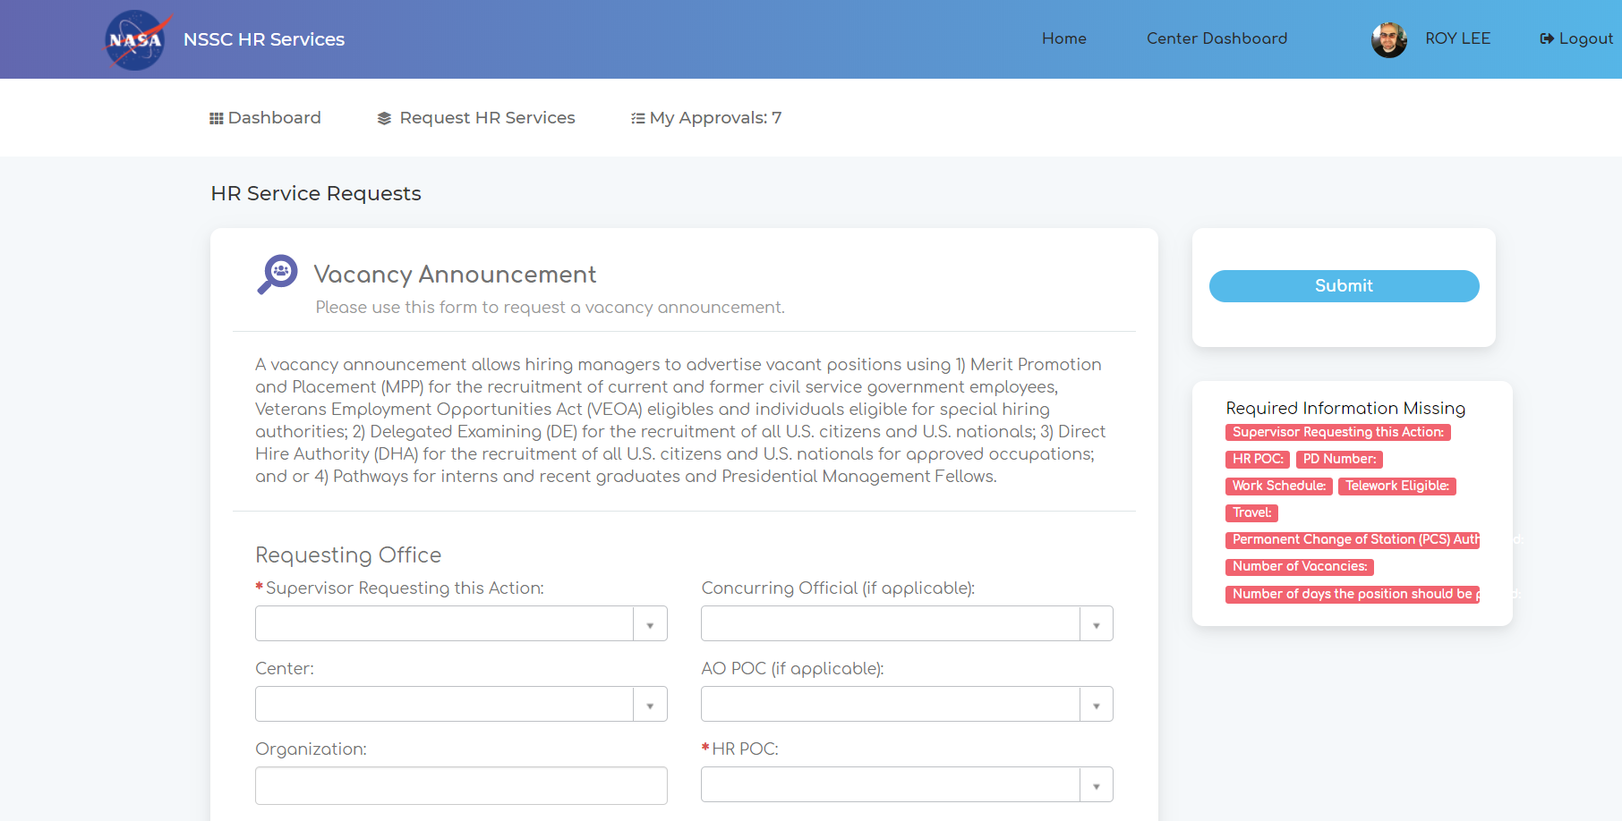

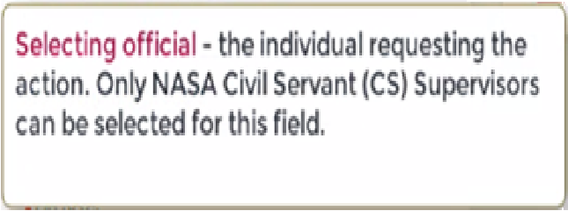

Slide 10
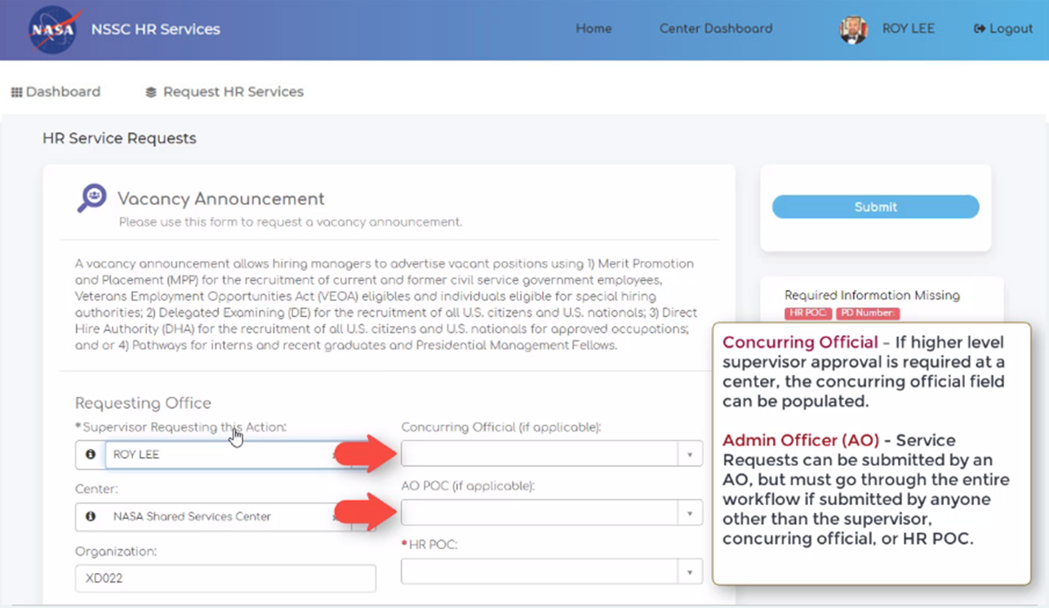

Slide 11
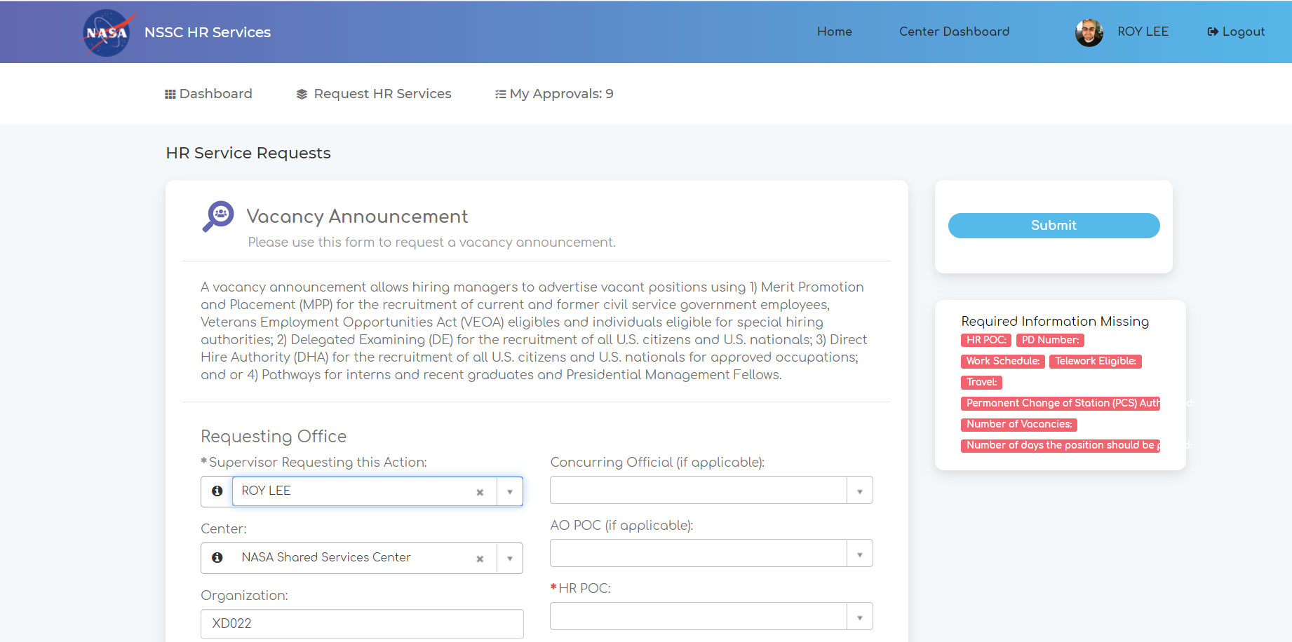


Slide 12
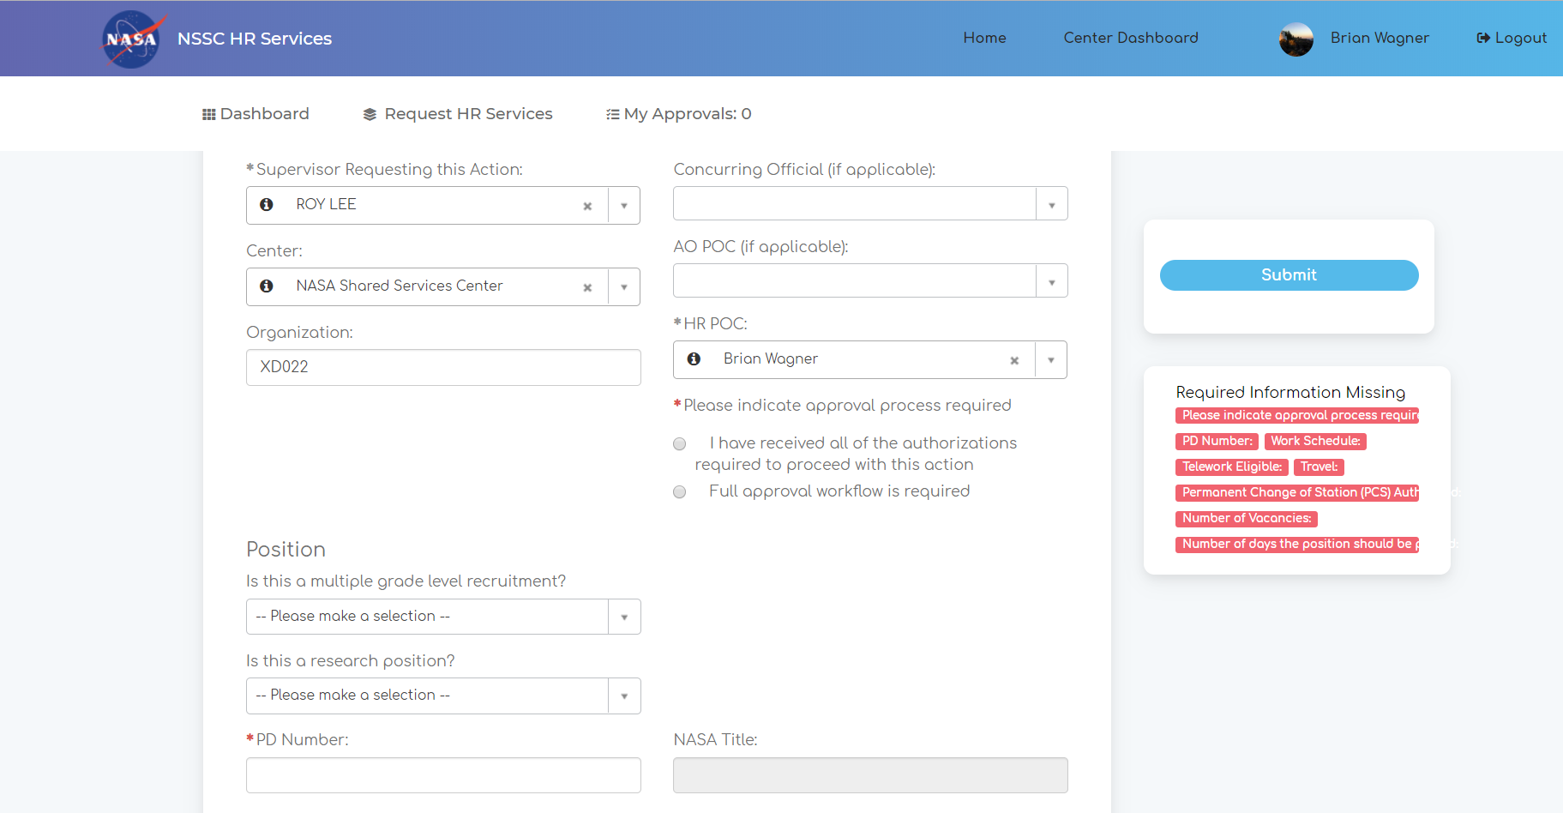
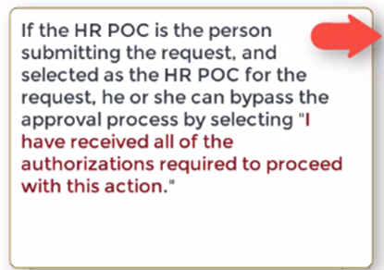
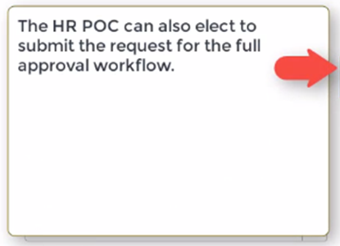

Slide 13
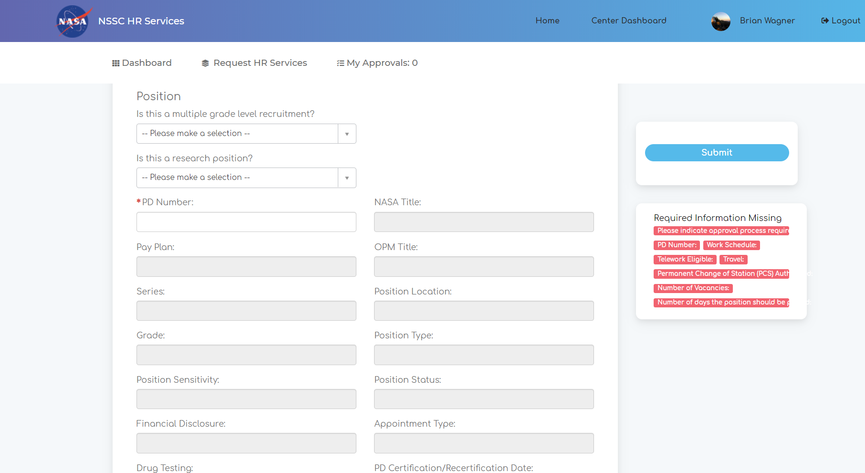
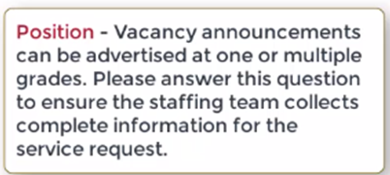

Slide 14
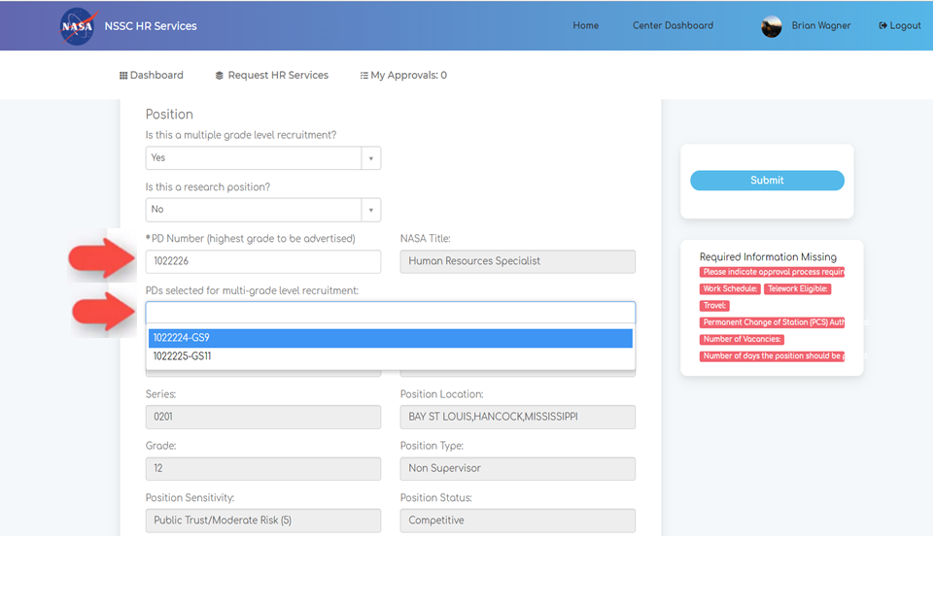
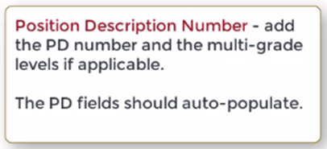

Slide 15
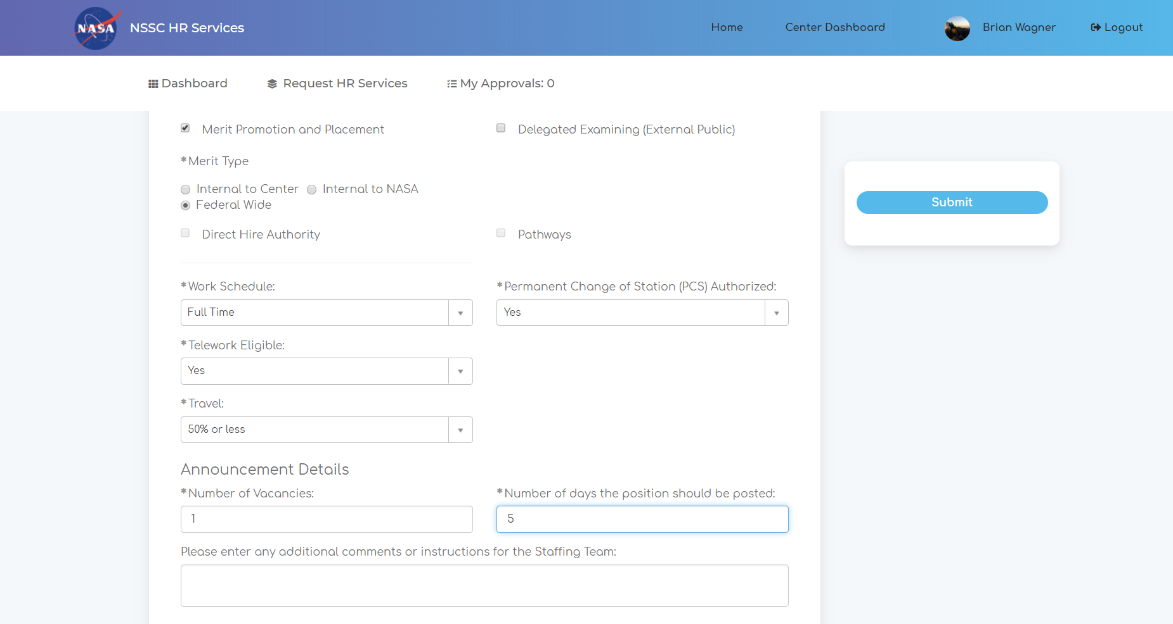

Slide 16
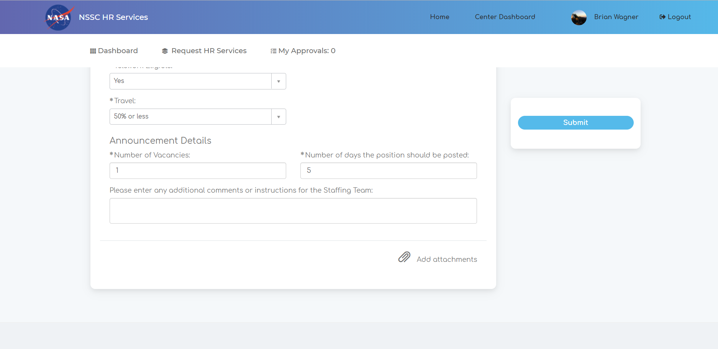

Slide 17
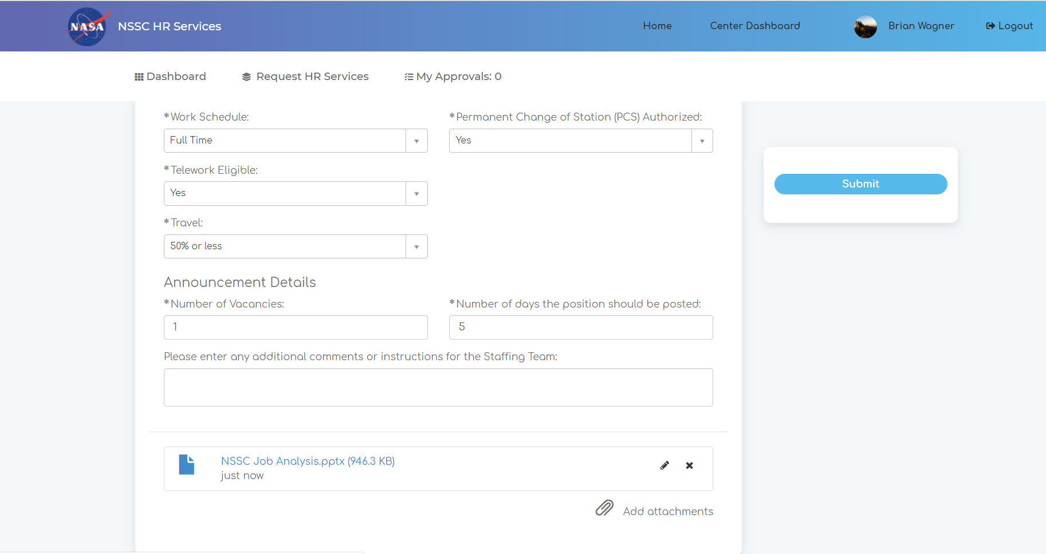

Slide 19
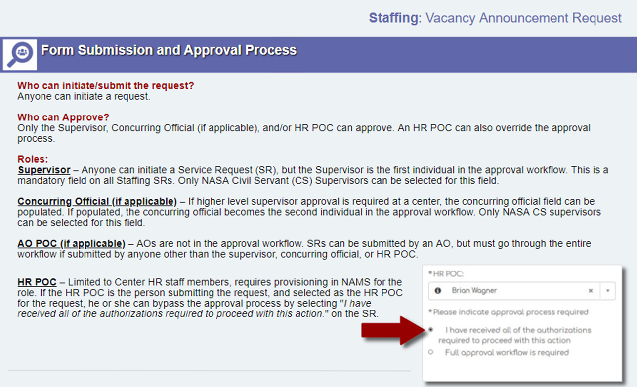

Slide 20
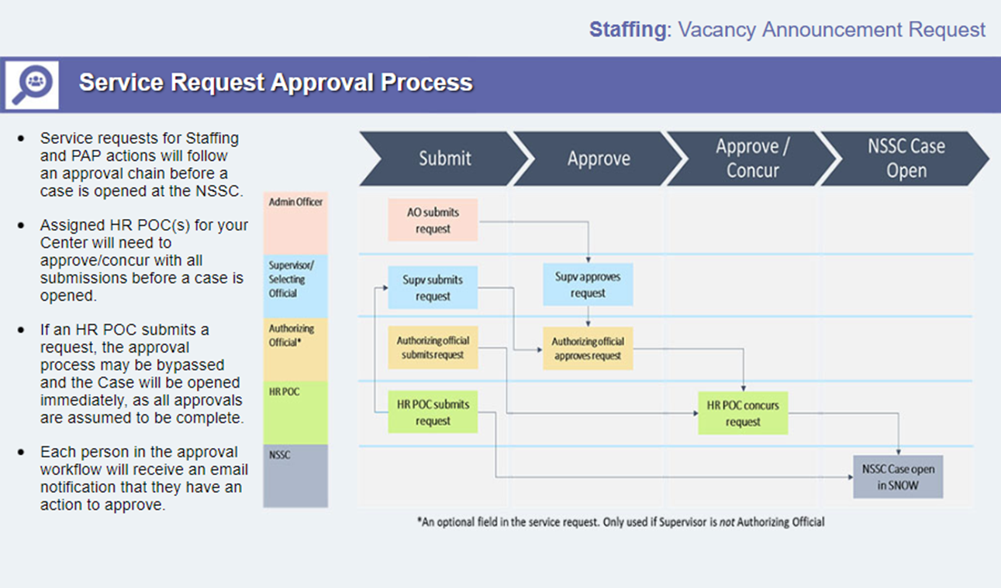

Slide 21
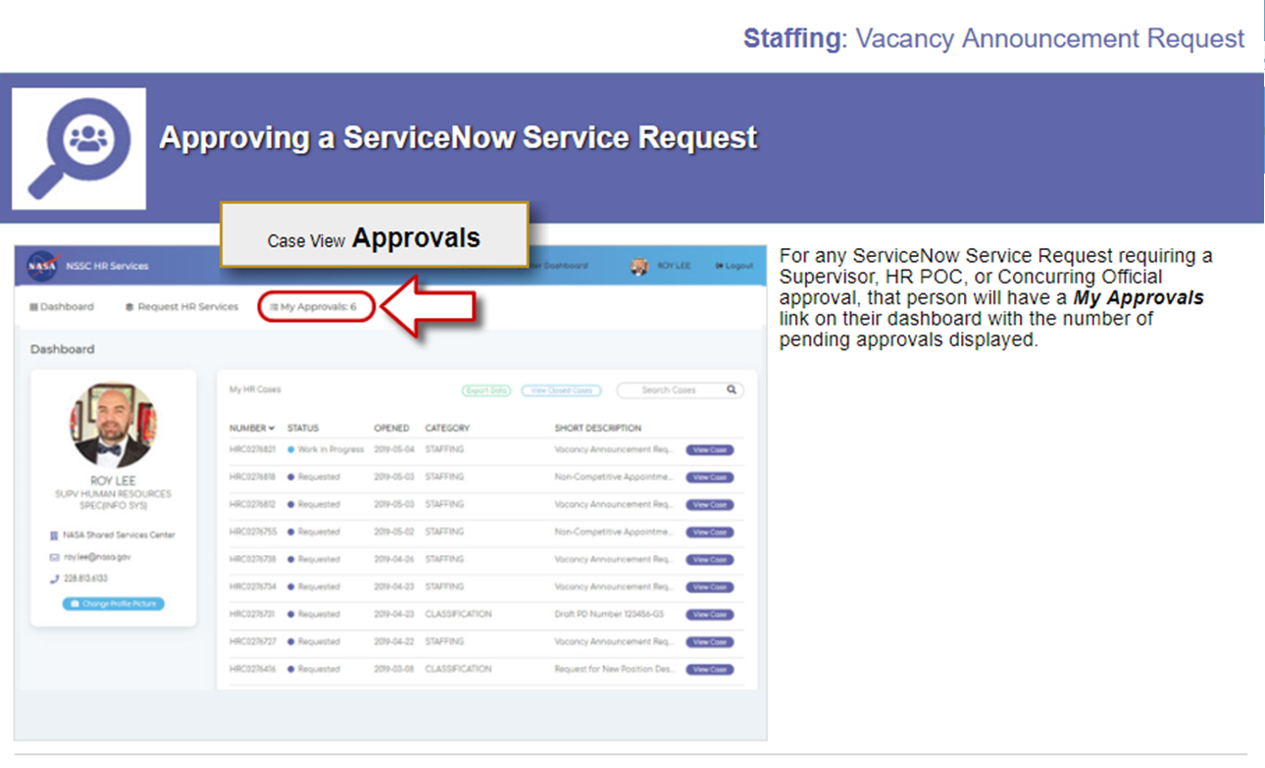

Slide 22
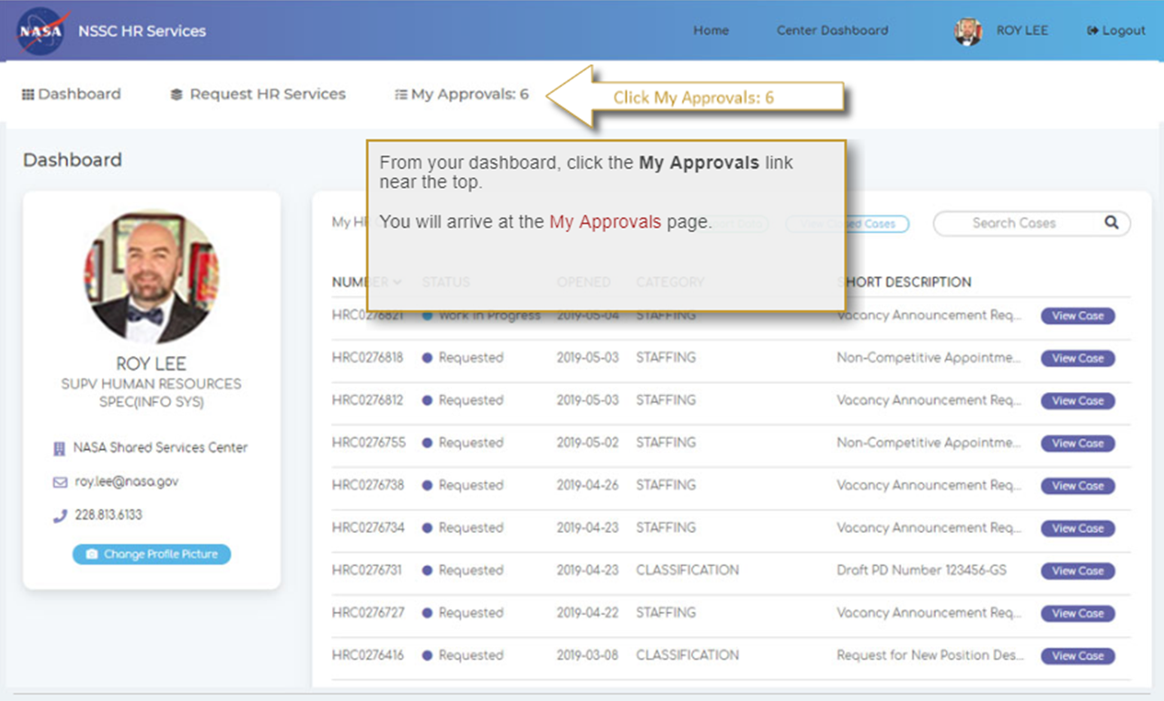

Slide 23
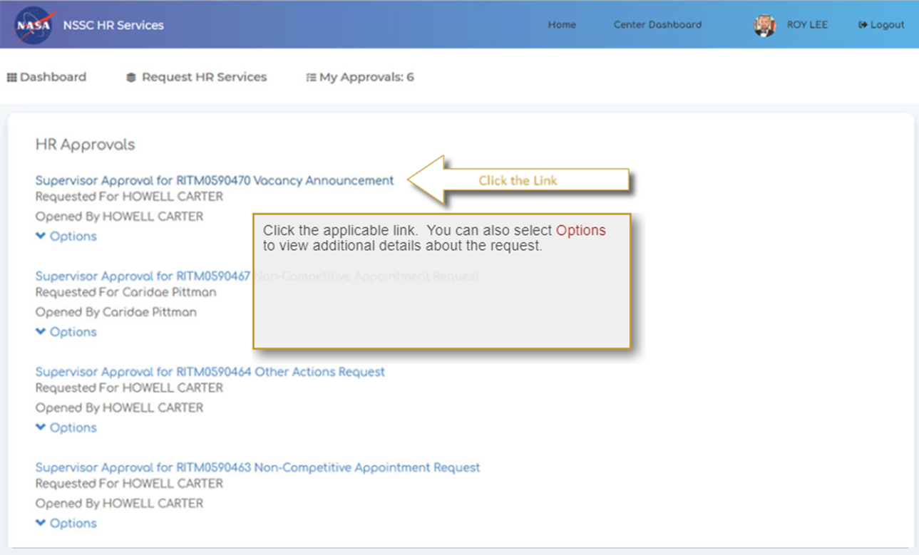

Slide 24
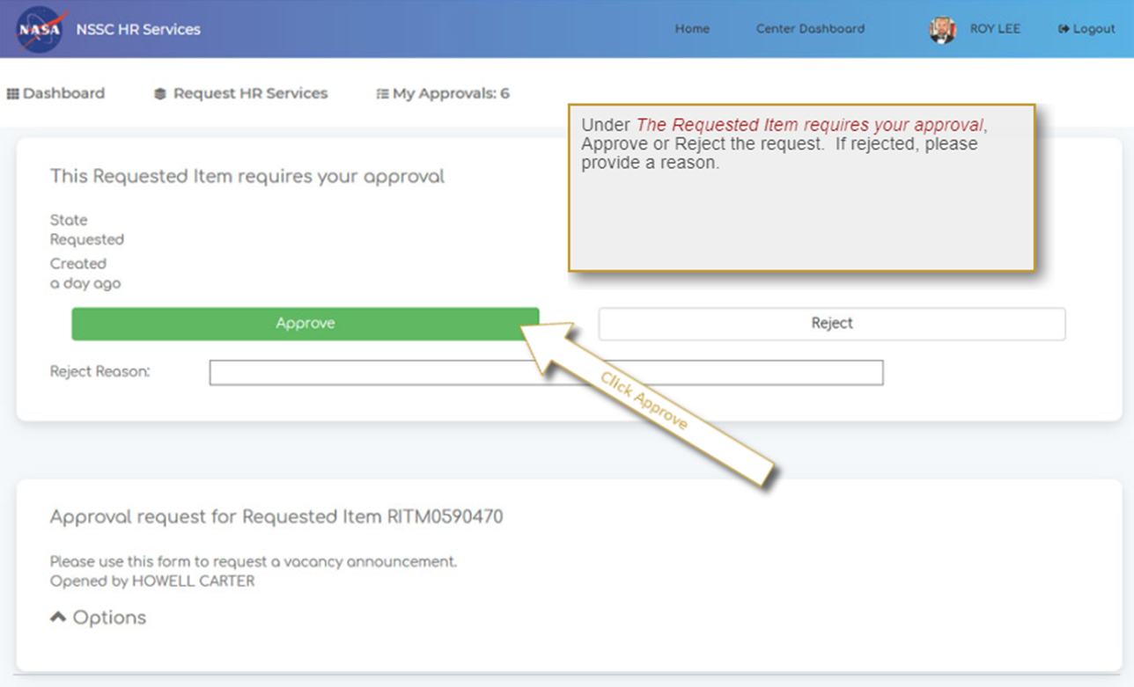

Slide 25
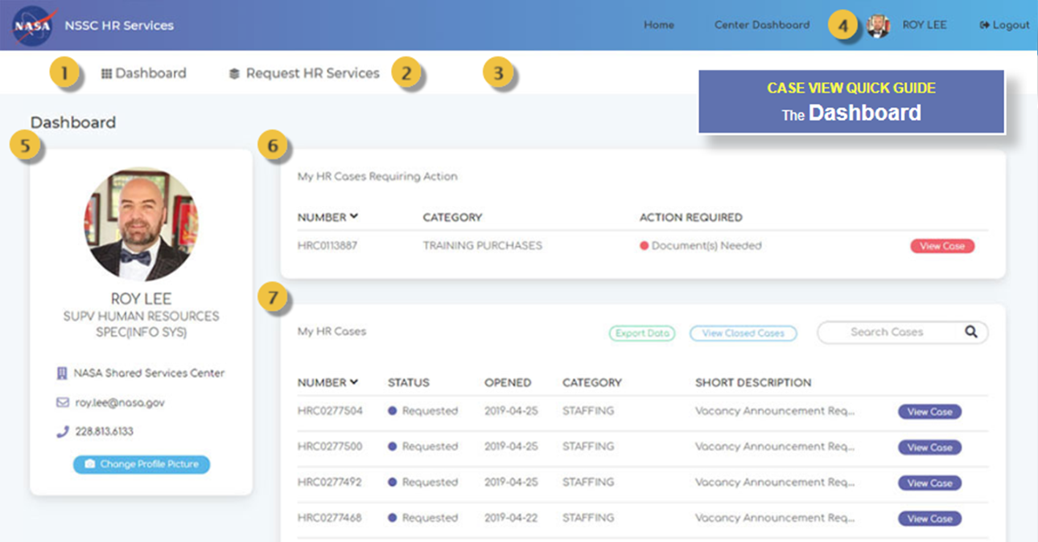
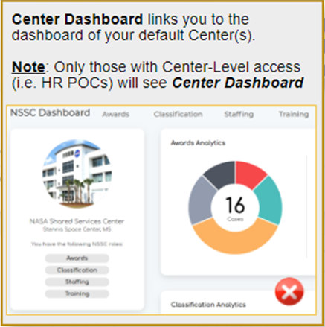
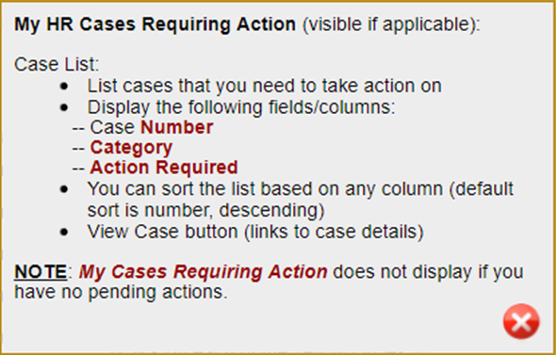
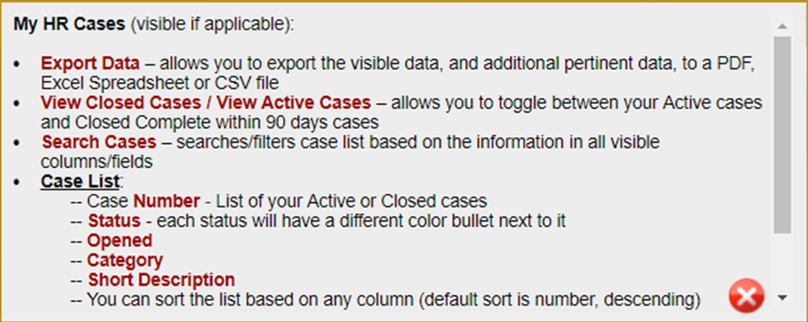

Slide 26
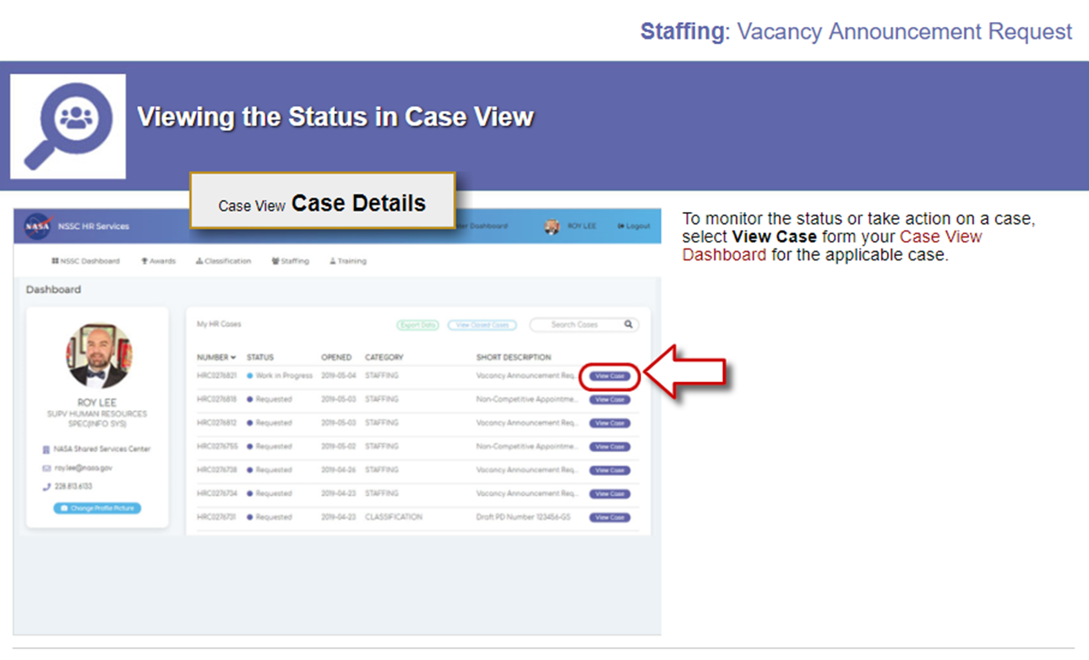

Slide 27
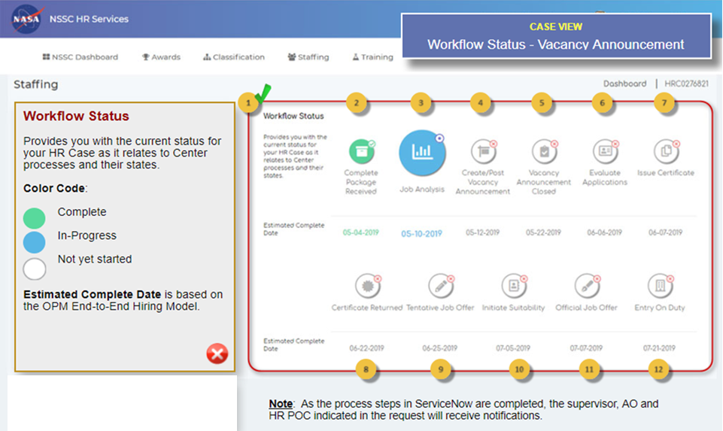
Notes:
Supervisors need details of each step

Slide 29
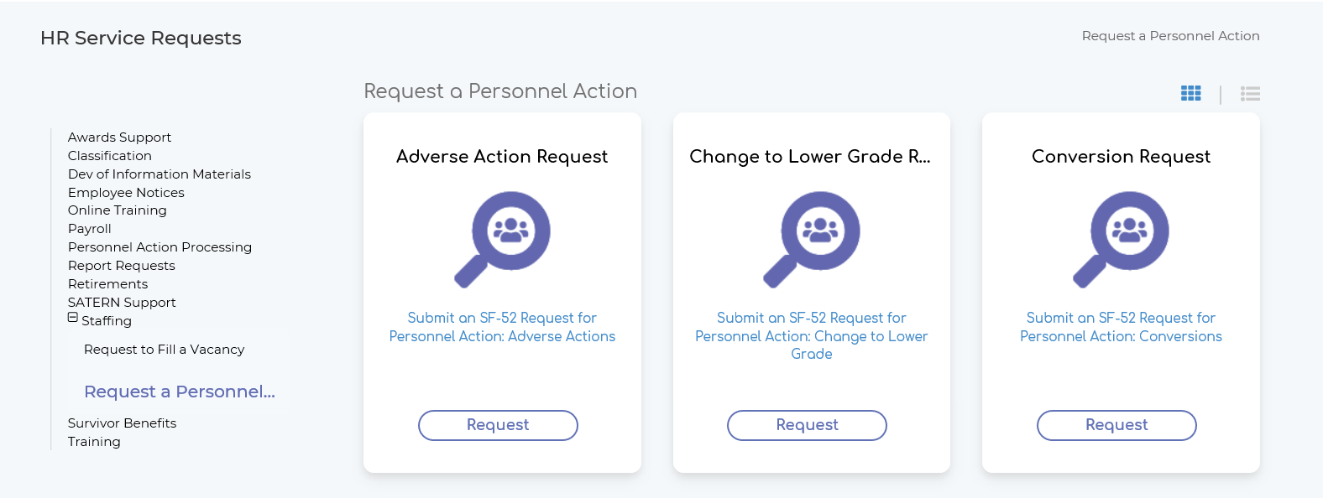
HR Request A Personnel Action

Slide 30
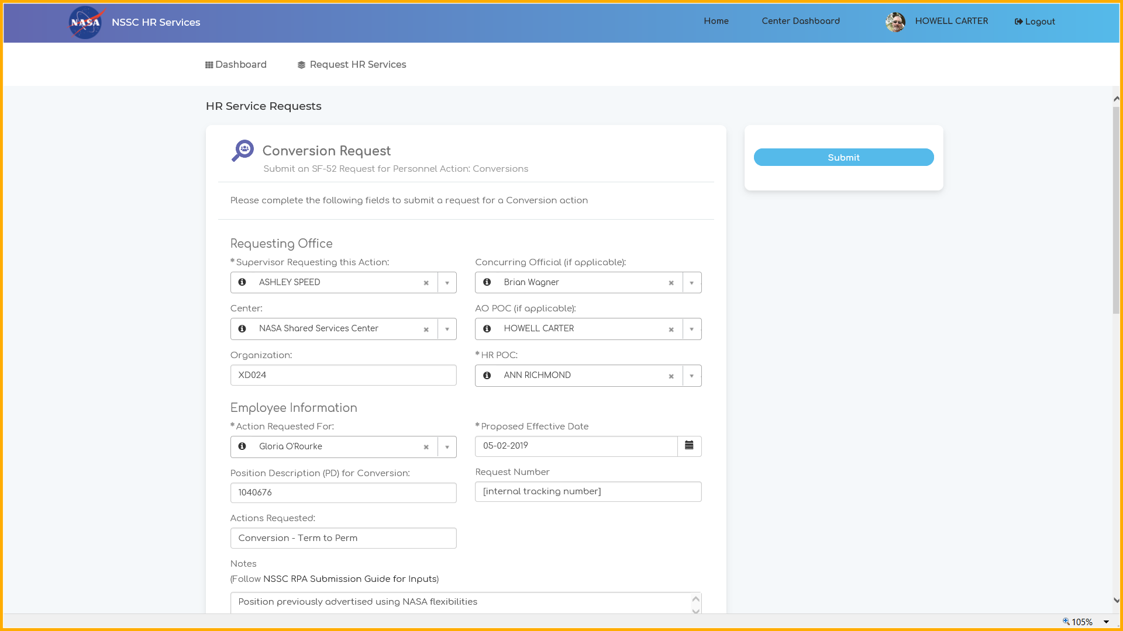
SF52 Request for Personnel Action and Approval

Slide 31
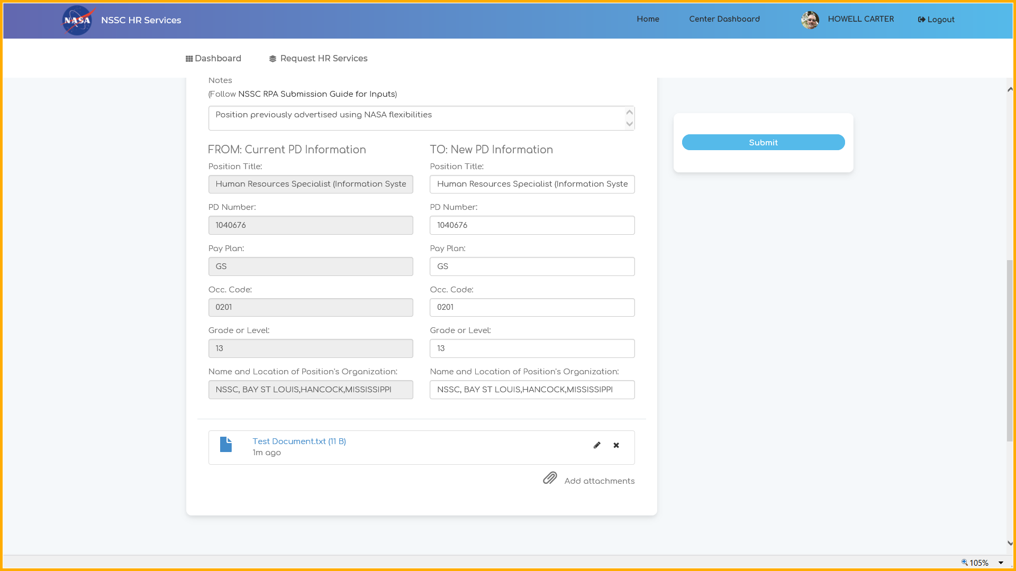
SF52 Request for Personnel Action and Approval

Slide 32

QUESTIONS
Type your questions in the chat
Any unanswered questions will be addressed in FAQs
You may also direct comments and feedback to the HC Transformation Inbox (hq-hc-transformation-feedback@mail.nasa.gov)

Slide 33

Visit the NSSC Staffing Services website for a copy of this briefing and the latest information related to Staffing Consolidation
https://www.nssc.nasa.gov/staffing

Slide 34
Transition of Staffing Services
BACKUP

Slide 35
Changes to role and responsibilities
 | Hiring Managers | Center HR Offices | NSSC Staffing Services Branch | Applicants/ Employees
START | Using ServiceNow to initiate all hiring and PAP actions Monitoring the status of their hiring and PAP actions and coordinating with NSSC via ServiceNow | Providing HR Business Partners (HRBPs) as strategic advisors to hiring managers Validating and/or submitting all requests for actions in ServiceNow | Providing reach back SME support on staffing regulations and policy to Center HROs Providing guidance to managers on category rating, Veterans preference, etc. Posting vacancy announcements, including development of job analysis Responding to applicant inquiries Performing qualifications and issuing certs (competitive and non-competitive hires) Making offers Acting as a liaison with Center HRO and selectee on incentives Inputting gains and publishing records in WTTS Processing ALL PAP functions in FPPS To maintain and distribute reports to Center HROs, e.g., NTE, WGI, Probationary Period
STOP | Using the RFE Portlet (HR Portal) to initiate hiring Using FPPS to initiate PAP actions Working with Center HR Specialist to complete hiring actions | Performing the staffing function and associated support (e.g., vacancy announcements, responding to inquiries, making offers) Processing all PAP actions in FPPS Inputting gains and publishing records in WTTS
CONTINUE | Obtaining authorization to fill positions at their Center To receive advice and consultation from Center HRO about recruitment strategies To provide information for job analysis (including skills) and vacancy announcement To manage the interview process To provide information for justifications To provide organizational orientation for new employees | To provide recruitment strategies and advice to hiring managers To manage and administer Pathways program, IPAs, Volunteer Interns Program, and Details To write justifications and gain approval for incentives, NEX, Fellows and other appointments requiring approval To act as Selective Placement Coordinator and Veteran Program Manager To ensure all CBA and local practices are followed To conduct onsite orientation |  | To apply for positions through USA Jobs To direct questions about vacancy announcements (VA) to the contact listed in the VA To provide onboarding/in-processing information to NSSC Caseworker To coordinate with their local Center HRO for orientation
 |  |  | To conduct in-processing/onboarding process
Notes:
The manager, applicant, and employee experience will not significantly change. Rather, in some cases, who they work with / contact for support will change.
With standardized processes and the use of ServiceNow to manage workflows, we hope that hiring managers will experience a more transparent, efficient hiring process.

