Slide 1
Staffing Consolidation
What this means for HR and how to request services
NSSC Staffing Services Branch
May 8, 2019

Slide 2
Welcome
Today we will cover..
What it means to “go live” on May 20th
Changes to HR office roles and responsibilities in the staffing process and processing of personnel actions
How to start a ticket (Staffing request and PAP)
How to monitor status of actions
How to submit a NAMS request for HR POC role and Case View access
Given time constraints, we will not cover…
Strategic questions about staffing consolidation, organization of the staffing branch, cost of services, etc.
Please direct questions like this to your HRD or you may send them to the HC Transformation Inbox (hq-hc-transformation-feedback@mail.nasa.gov)
IMPORTANT
Please hold questions until the end (chat will be closed during presentation)
Time for questions will be limited; remaining questions will be addressed in FAQs
Session is being recorded and will be available at a later date

Slide 3
On May 20th staffing services for all Centers will transition to the NSSC; transition includes residual personnel action services going to NSSC
 | Category A Centers: Ready for full implementation GRC, GSFC, JSC, KSC, NSSC and SSC | Category B Centers: Gradual transition Cali HR (AFRC/ ARC), HRMD, LaRC, MSFC
HRBP model | HRBPs in place and acting as strategic advisors to customers | Preparing for HRBP implementation
Customer experience | Center HROs communicate with supervisors about staffing consolidation and NSSC staffing services Supervisors and managers will attend Staffing Transition training webinar on May 9th | Supervisors perceive no change in their experience and receive no communication about staffing consolidation Continue to conduct business as usual when in need of support for staffing or personnel action services
Initiating and monitoring requests | HRBPs, supervisors, managers, and/or AOs may submit and monitor requests for staffing and personnel action services via ServiceNow Staffing and personnel action service requests will follow an approval chain before a case is opened at NSSC | Only servicing HR office will submit and monitor requests for staffing services via ServiceNow Approach for requesting personnel actions will be discussed by Center HRDs and NSSC
Pipeline work | All staffing work in progress by Staffing Specialist Detailees will transition to the NSSC; staffing work not being performed by Detailees will be completed by Center HRO All requests for personnel actions already initiated in FPPS, will be coded and LGAP’d by the Center
HCIT systems | RFE Portlet decommissioned; ServiceNow is official system for requesting all staffing and personnel actions NSSC will code, route and LGAP all personnel actions in FPPS; they will also input gains and publish records in WTTS | RFE Portlet decommissioned; ServiceNow is official system for requesting all staffing and personnel actions Impacts to FPPS route paths to be determined by Center; NSSC will input gains and publish records in WTTS
Notes:
Staffing work will be completed by Staffing Specialists detailed to the NSSC, but there will be subtle differences in how that work is initiated and monitored, based on Center HROs’ readiness for implementation

Slide 4
What are the impacts to those involved?
 | Hiring Managers | Center HR Offices | NSSC Staffing Services Branch | Applicants/ Employees
START | Using ServiceNow to initiate all hiring and personnel actions Monitoring the status of their hiring and PAP actions and coordinating with NSSC via ServiceNow | Providing HR Business Partners (HRBPs) as strategic advisors to hiring managers Validating and/or submitting all requests for actions in ServiceNow | Providing reach back SME support on staffing regulations and policy to Center HROs Providing guidance to managers on category rating, Veterans preference, etc. Posting vacancy announcements, including development of job analysis Responding to applicant inquiries Performing qualifications and issuing certs (competitive and non-competitive hires) Making offers Acting as a liaison with Center HRO and selectee on incentives Inputting gains and publishing records in WTTS Processing ALL personnel actions in FPPS To maintain and distribute reports to Center HROs, e.g., NTE, WGI, Probationary Period
STOP | Using the RFE Portlet (HR Portal) to initiate hiring Using FPPS to initiate personnel actions Working with Center HR Specialist to complete hiring actions | Performing the staffing function and associated support (e.g., vacancy announcements, responding to inquiries, making offers) Processing personnel actions in FPPS Inputting gains and publishing records in WTTS
CONTINUE | Obtaining authorization to fill positions at their Center To receive advice and consultation from Center HRO about recruitment strategies To provide information for job analysis (including skills) and vacancy announcement To manage the interview process To provide information for justifications To provide organizational orientation for new employees | To provide recruitment strategies and advice to hiring managers To manage and administer Pathways program, IPAs, Volunteer Interns Program, and Details To write justifications and gain approval for incentives, NEX, Fellows and other appointments requiring approval To act as Selective Placement Coordinator and Veteran Program Manager To ensure all CBA and local practices are followed To conduct onsite orientation |  | To apply for positions through USA Jobs To direct questions about vacancy announcements (VA) to the contact listed in the VA To provide onboarding/in-processing information to NSSC Caseworker To coordinate with their local Center HRO for orientation
 |  |  | To conduct in-processing/onboarding process
Notes:
Although NSSC will be performing staffing functions, Center HROs will retain some responsibilities in the process
The manager, applicant, and employee experience will not significantly change. Rather, in some cases, who they work with / contact for support will change.
With standardized processes and the use of ServiceNow to manage workflows, we hope that hiring managers will experience a more transparent, efficient hiring process.

Slide 5
Staffing Consolidation
ServiceNow, Case View, and NAMS requests

Slide 6
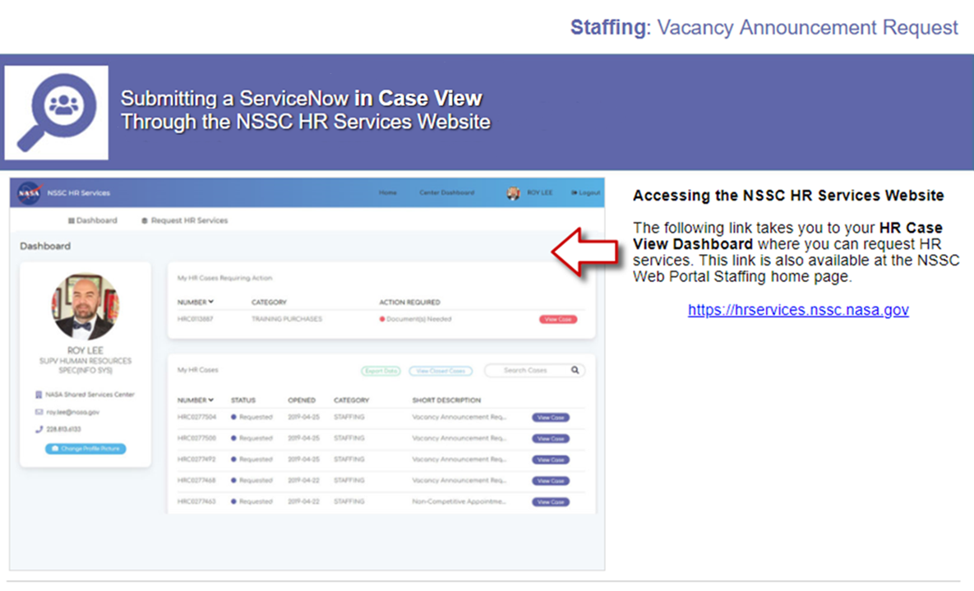

Slide 7
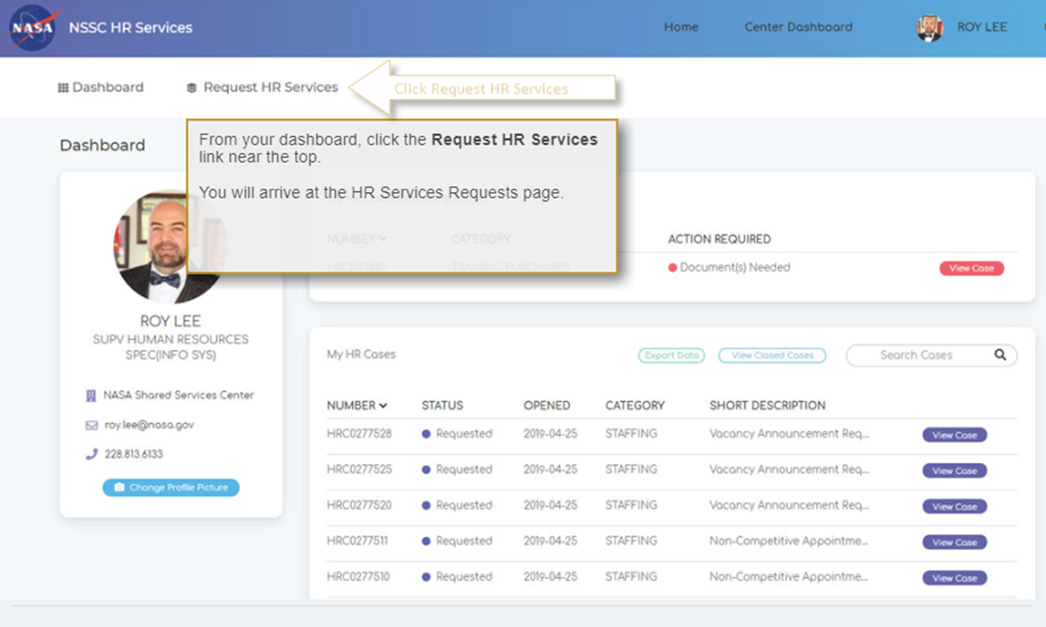

Slide 8
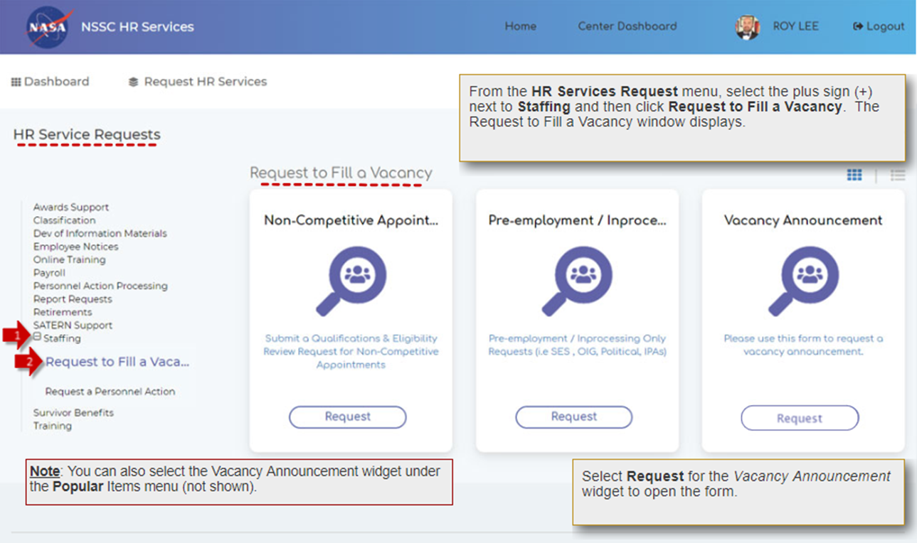
3

Slide 9
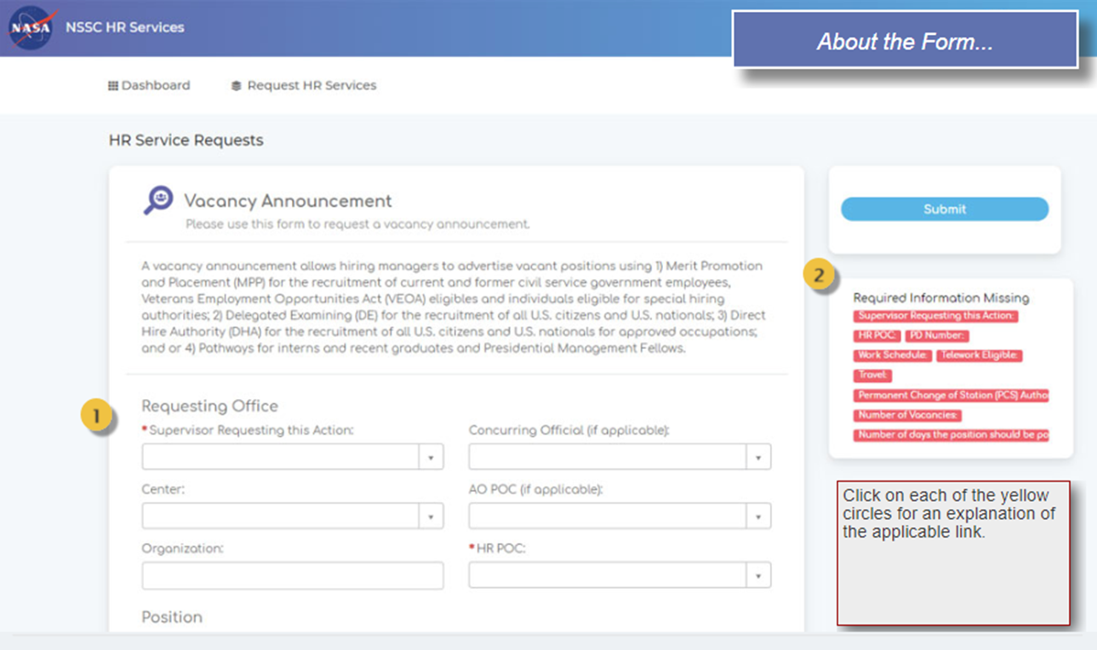

Slide 10
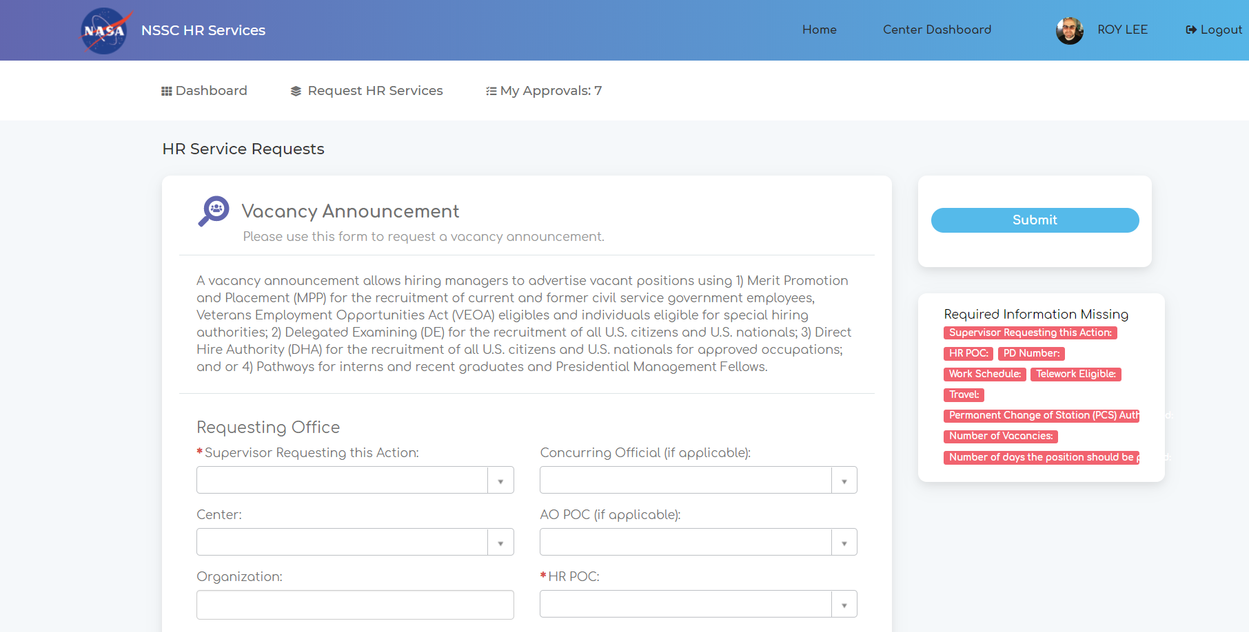

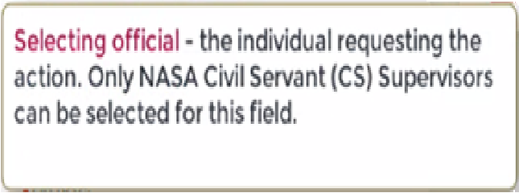

Slide 11
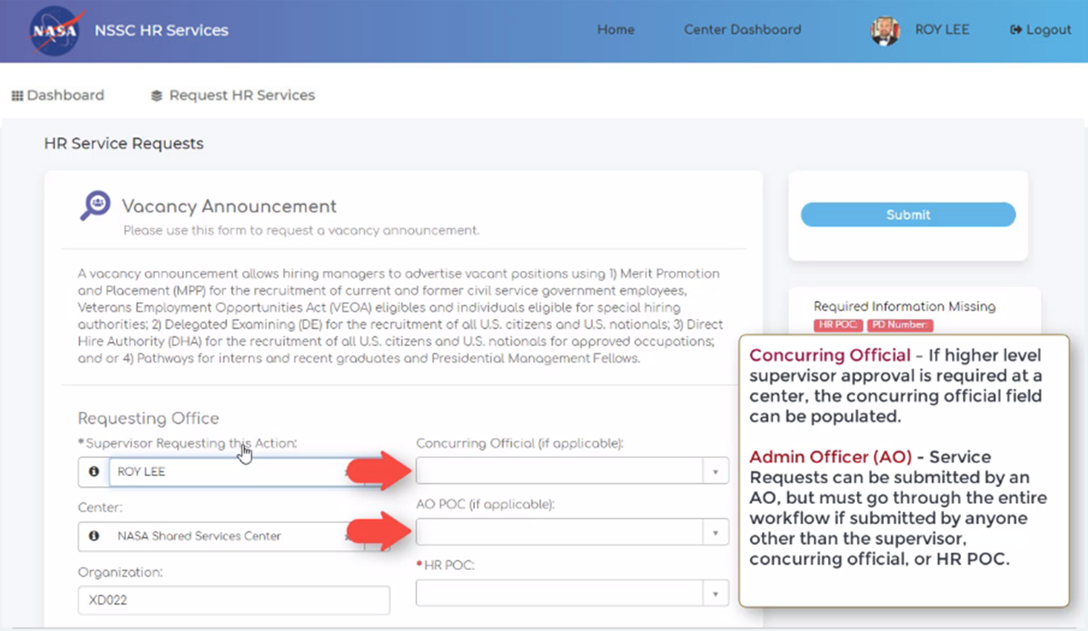

Slide 12
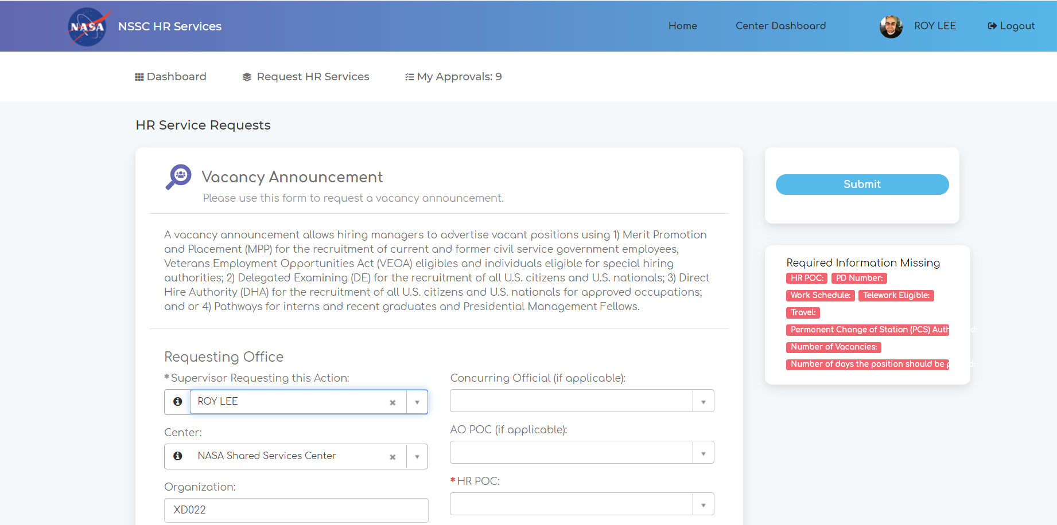
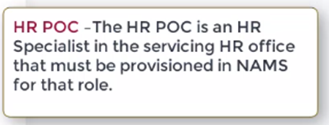

Slide 13
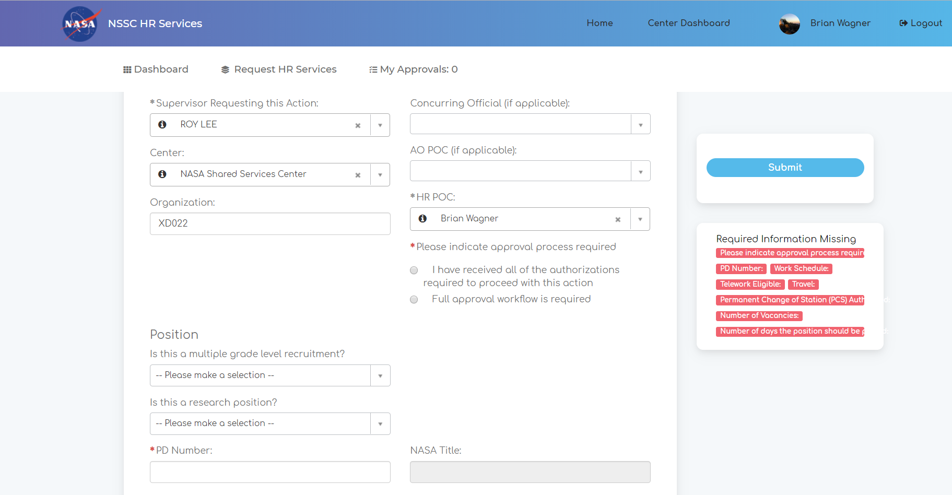
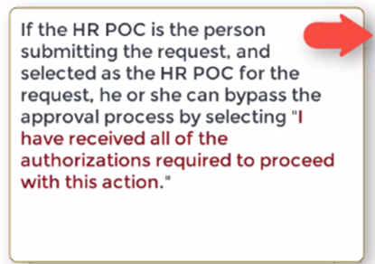

Slide 14
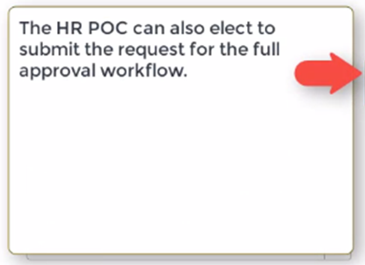

Slide 15
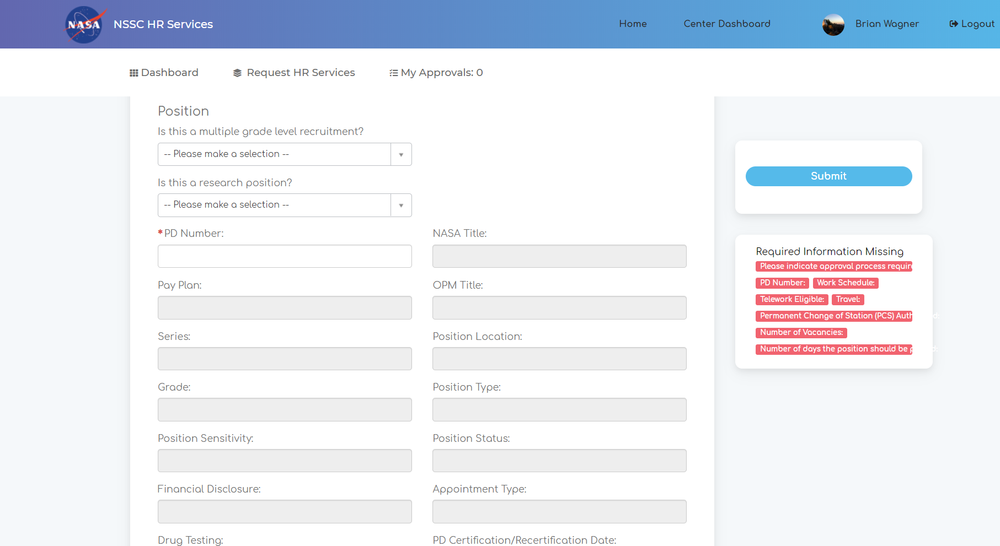
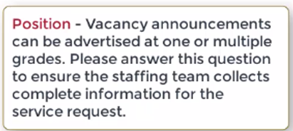

Slide 16
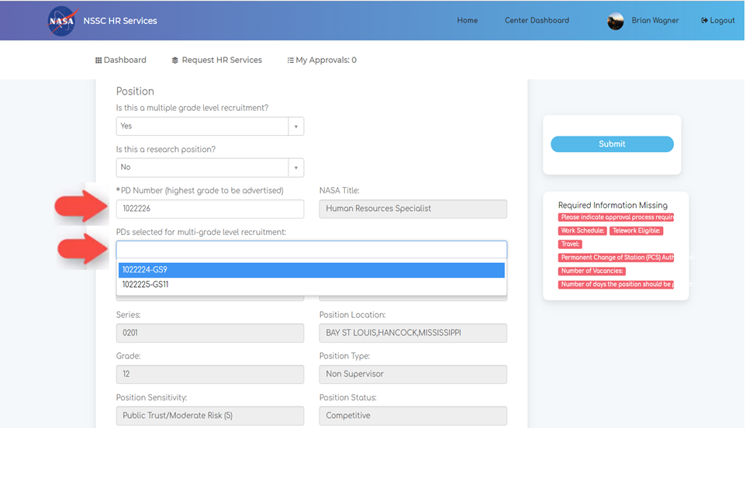
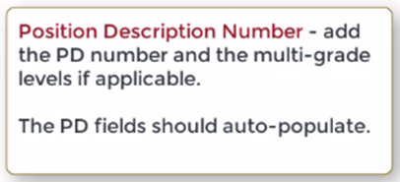

Slide 17
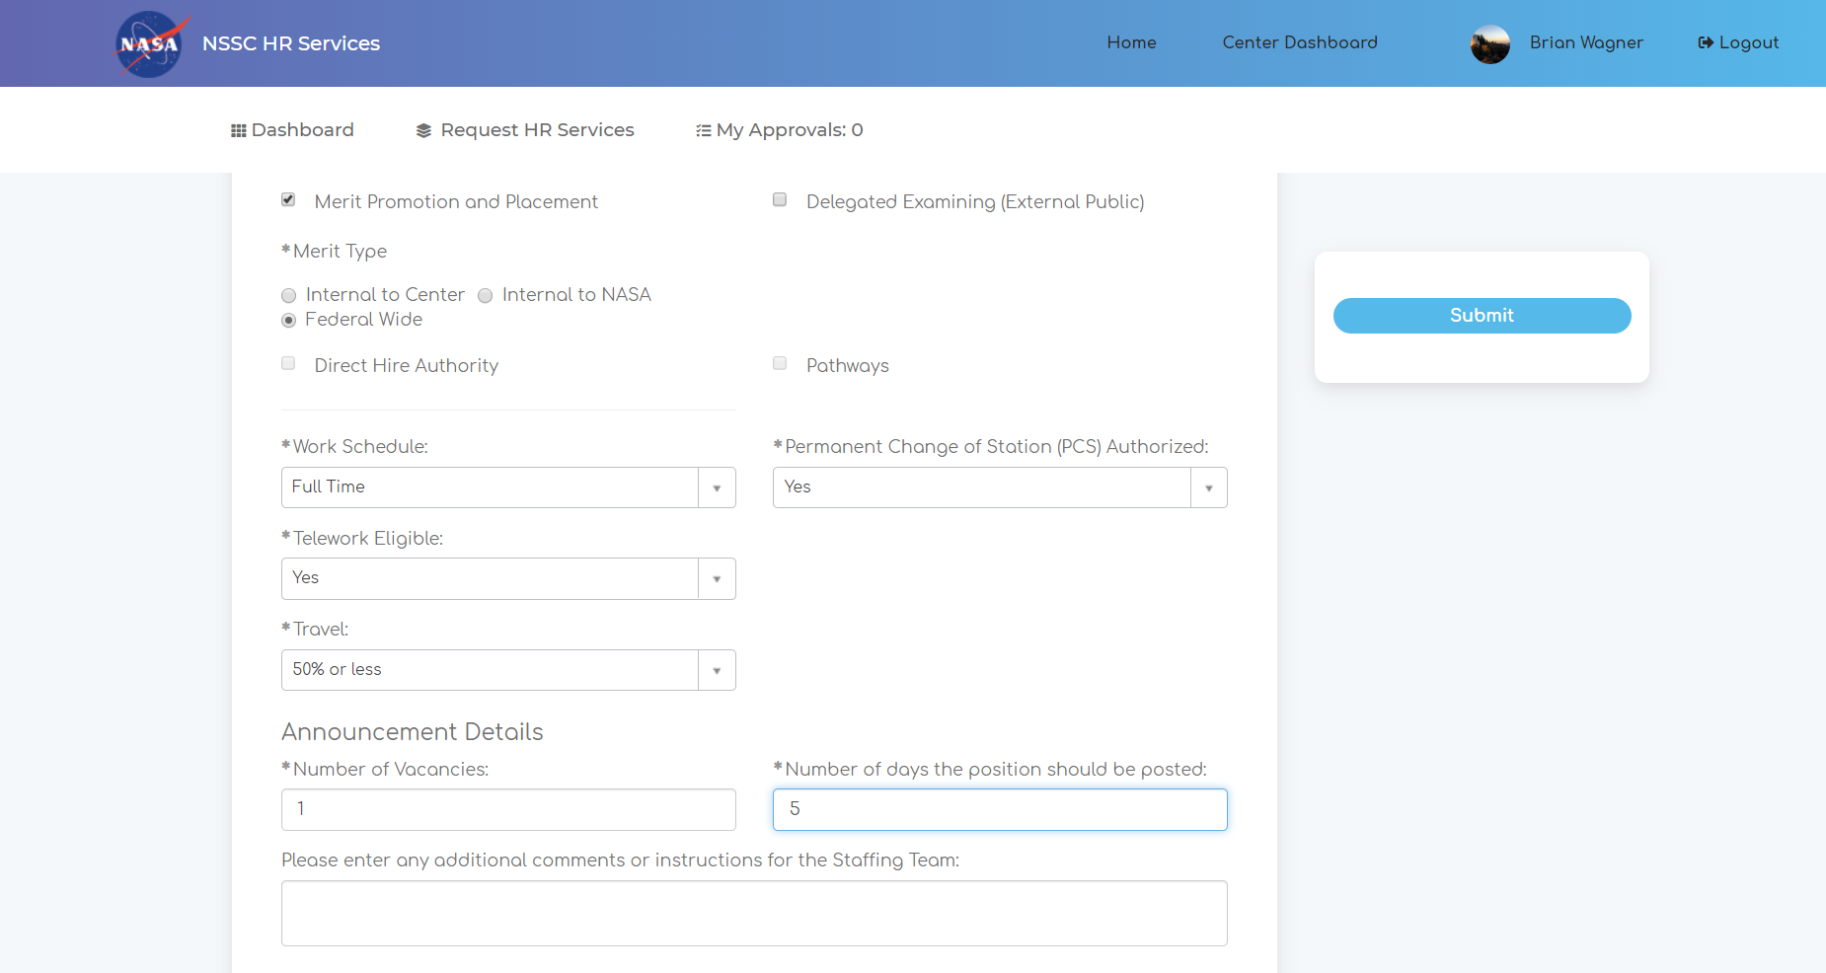

Slide 18
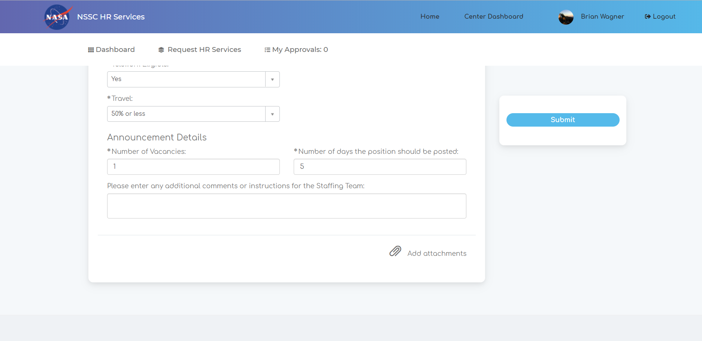

Slide 19
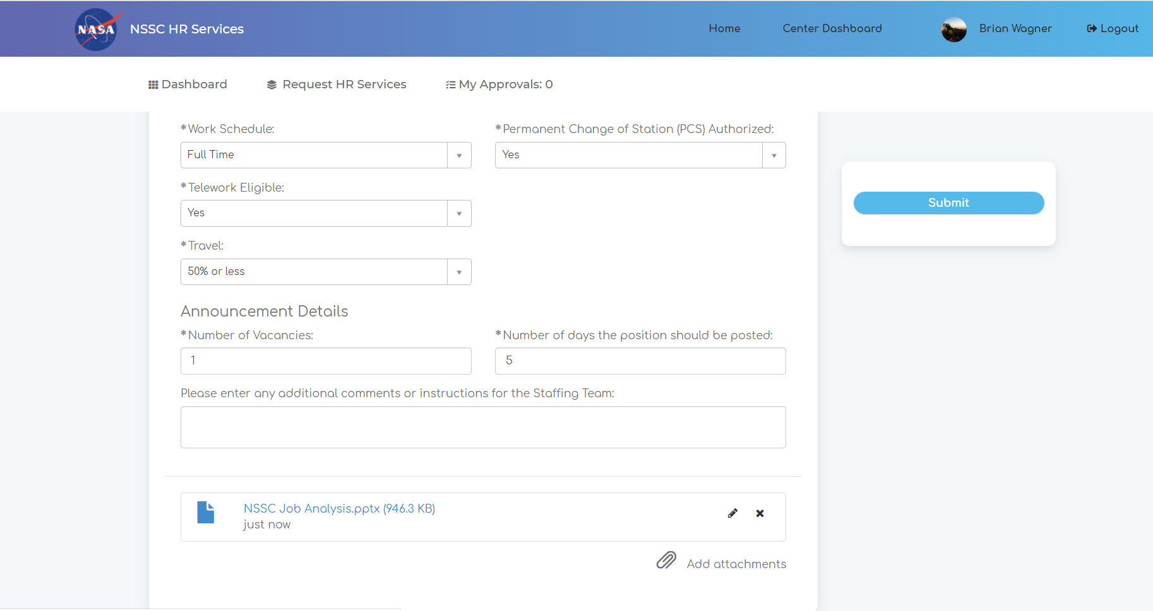

Slide 21
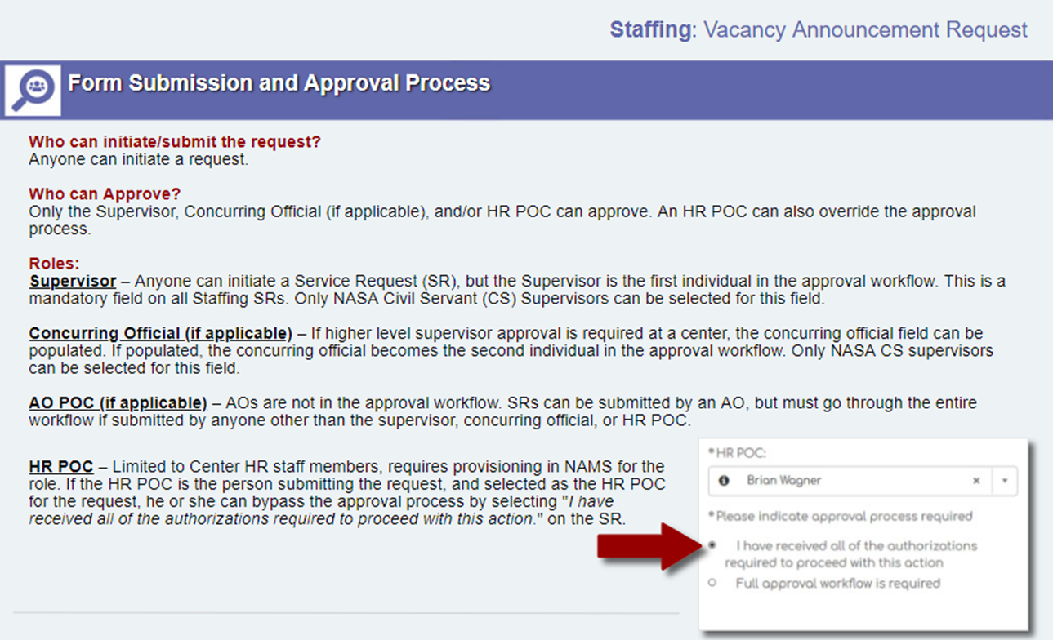

Slide 22
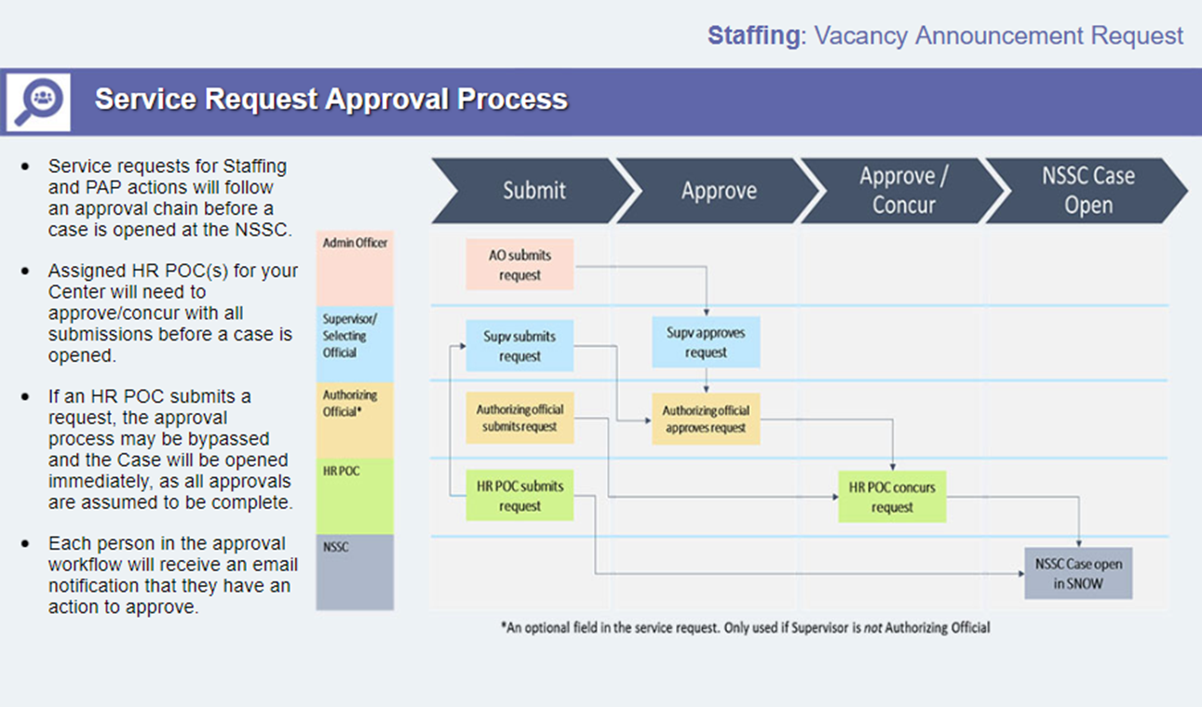
Note: Category A centers may follow any of the above scenarios on May 20th; Category B Center requests will only be submitted by HR POCs (or locally seated NSSC Staffing Detailee). The RFE will not be available through the HR Portal to submit requests.

Slide 23
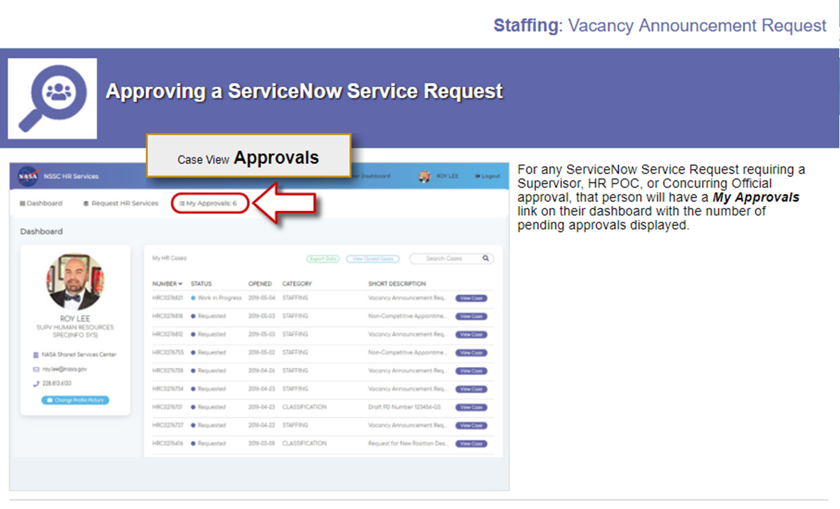

Slide 24
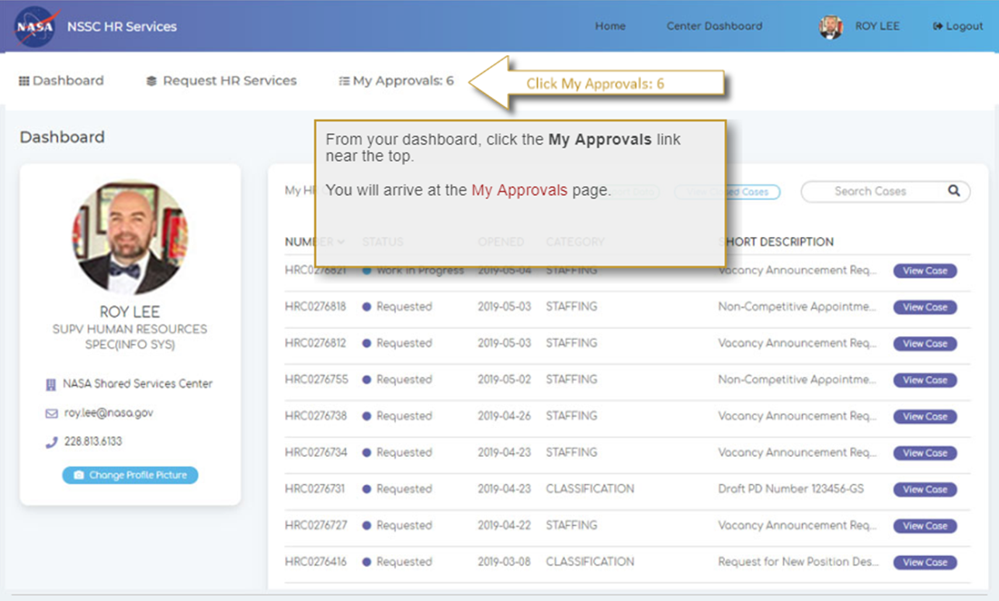

Slide 25
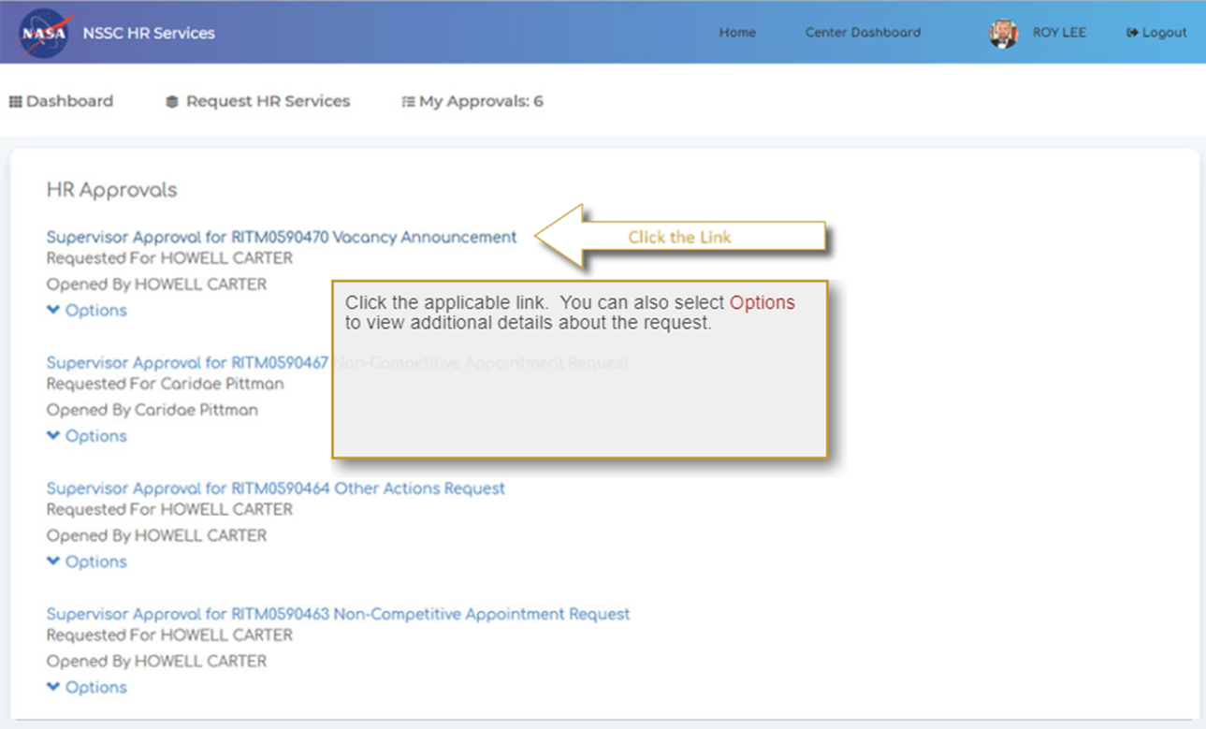

Slide 26
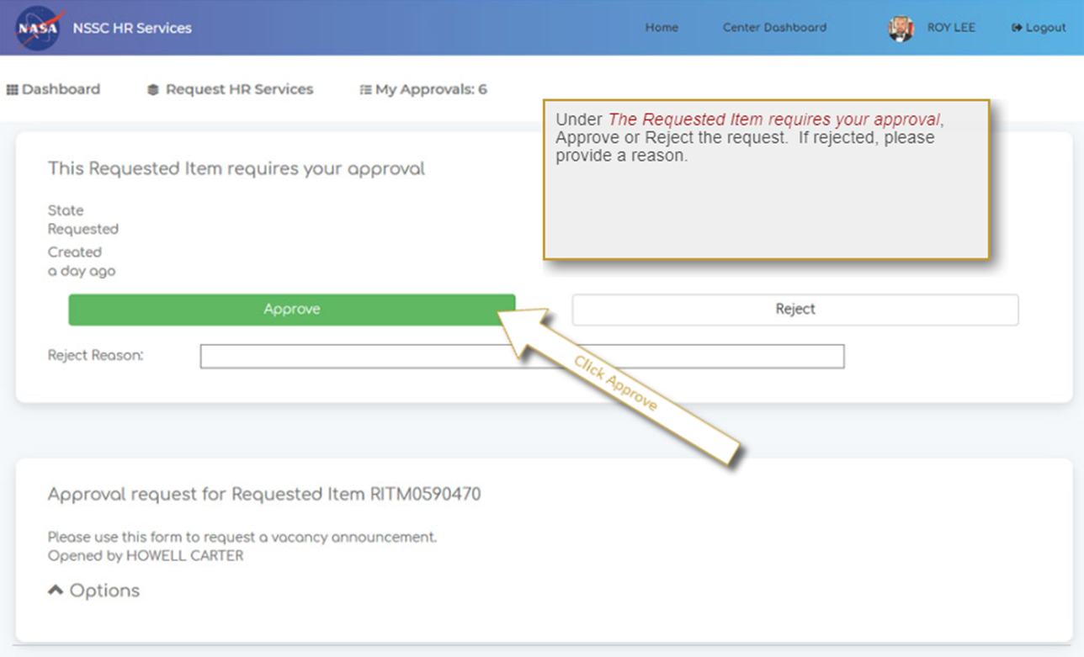

Slide 27
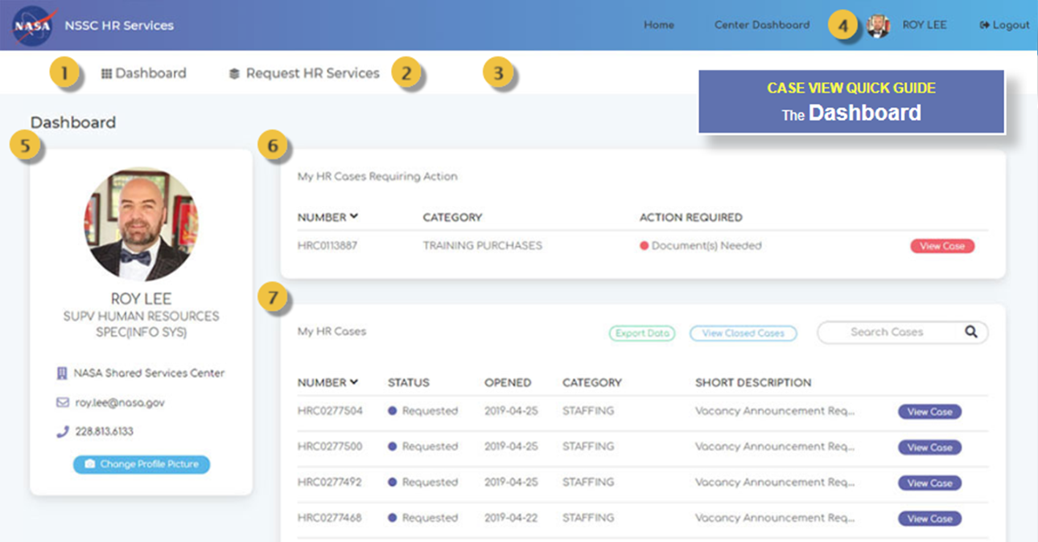
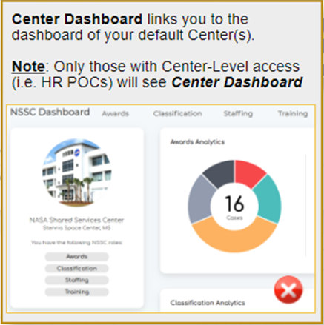
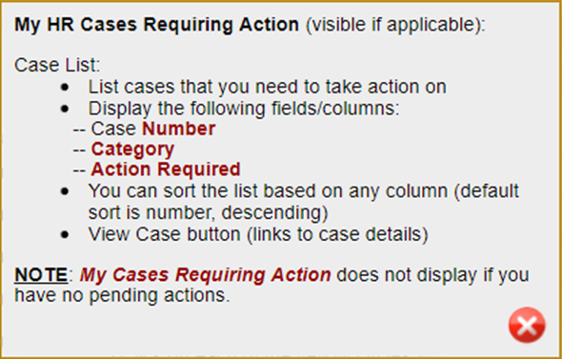
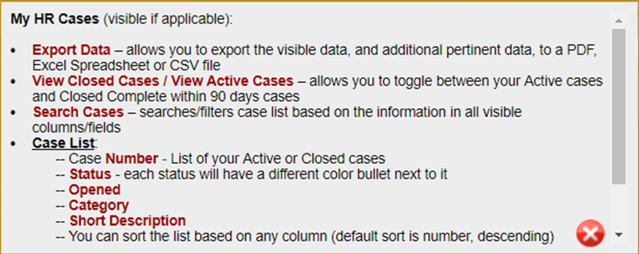

Slide 28
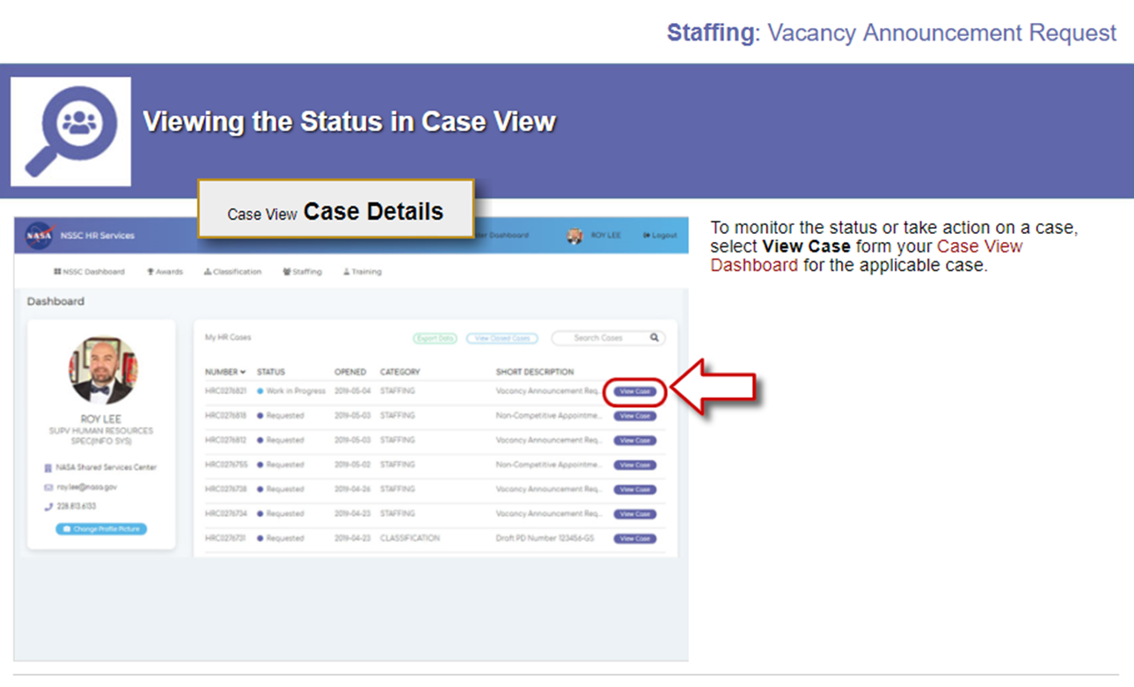

Slide 29
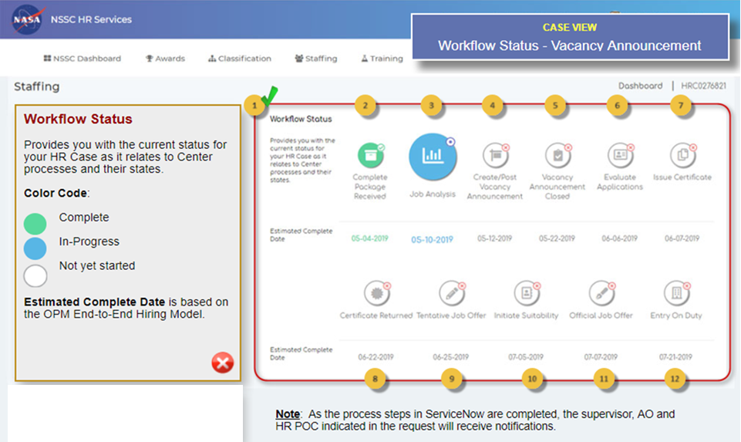

Slide 31
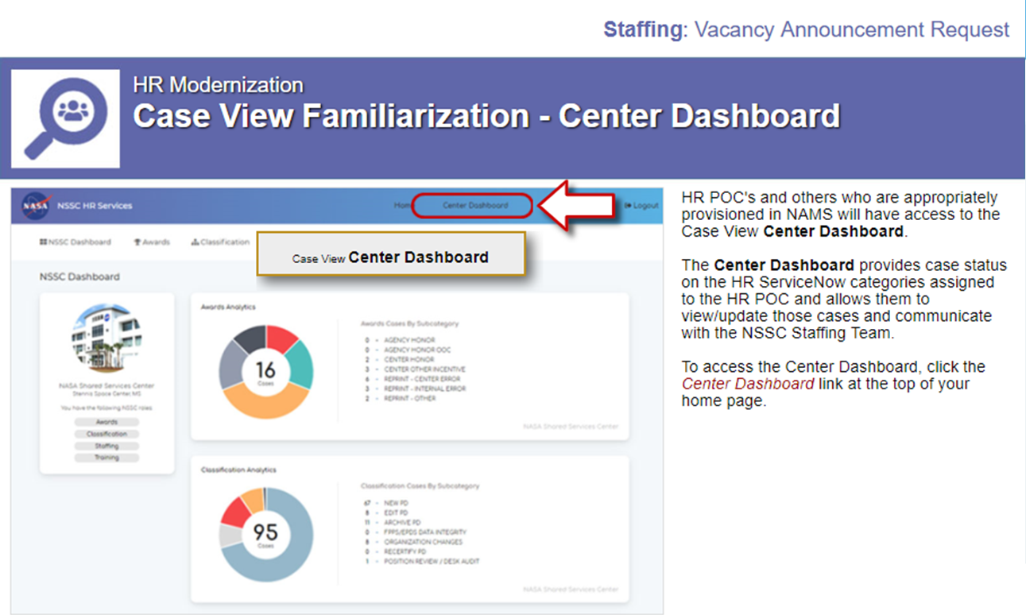

Slide 32
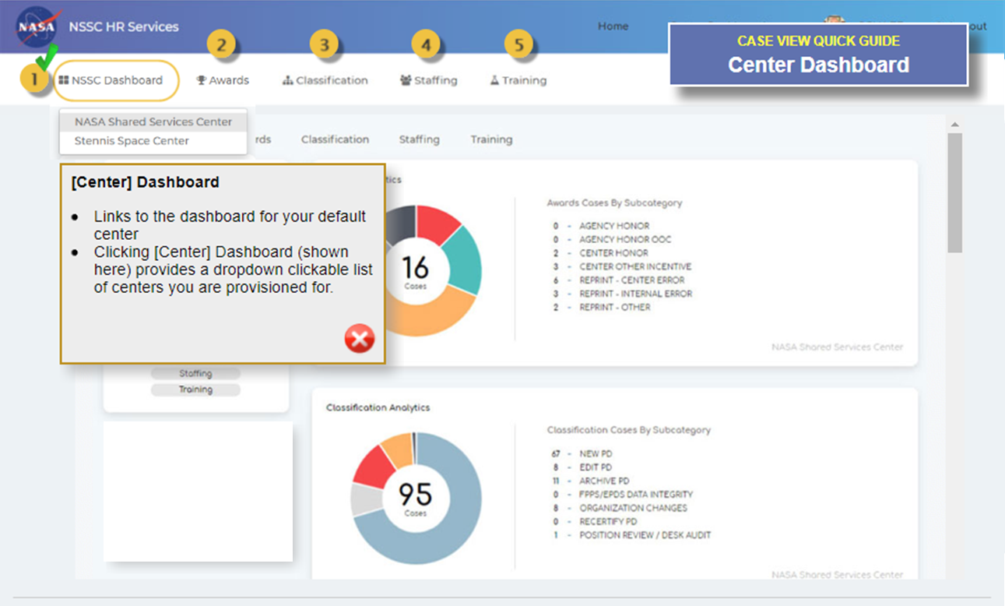

Slide 33
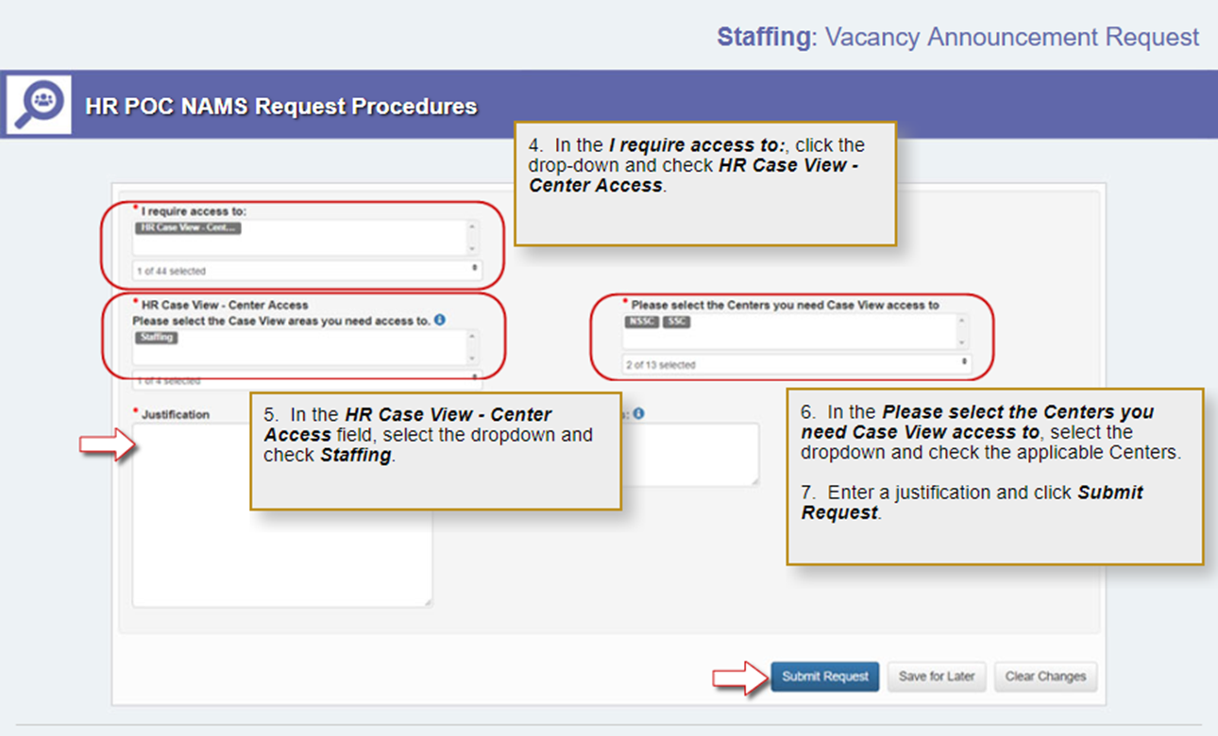

Slide 34
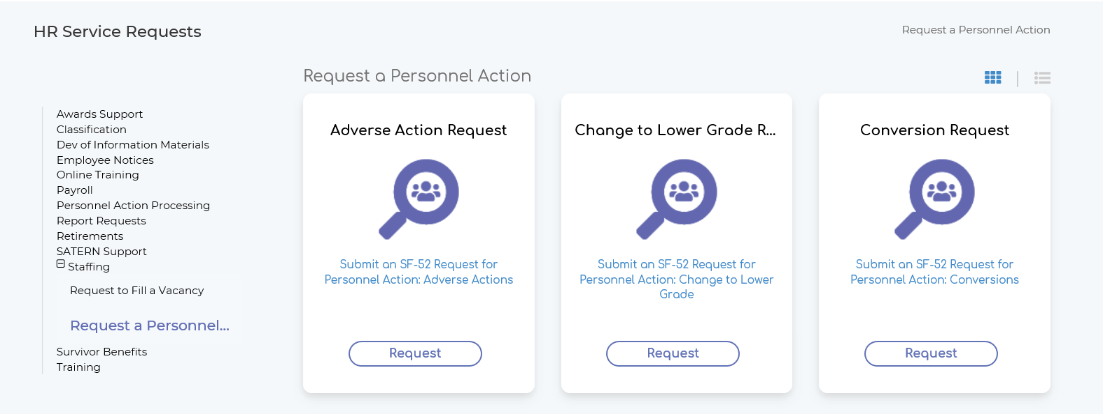
HR Request A Personnel Action

Slide 35
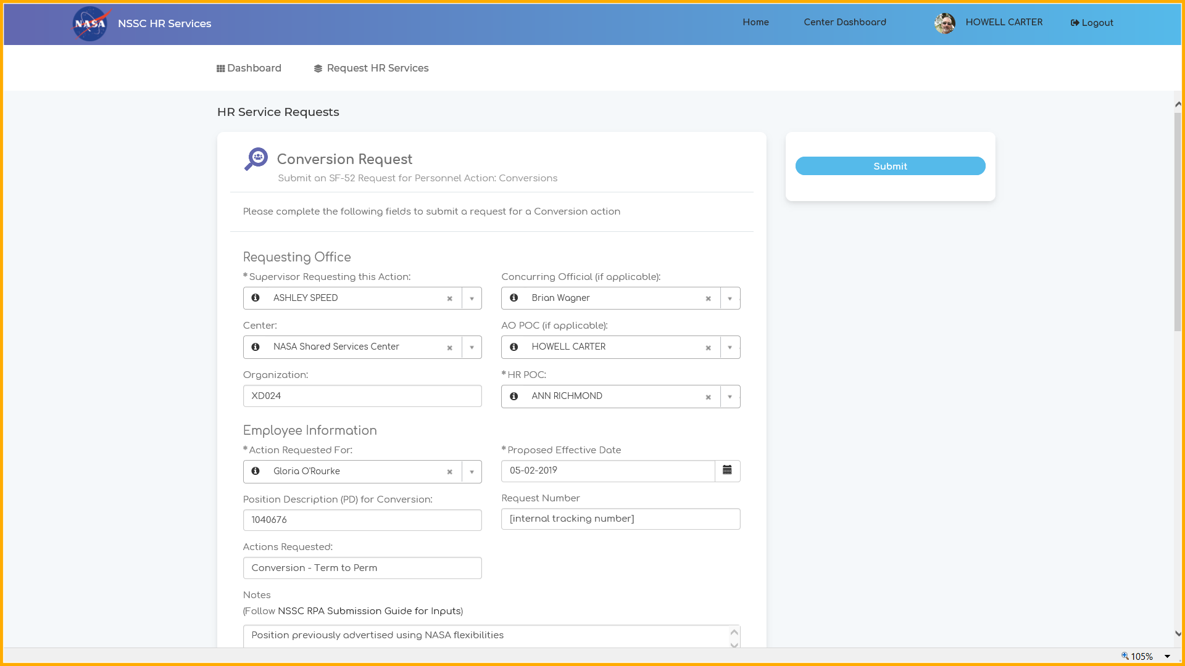
SF52 Request for Personnel Action and Approval

Slide 36
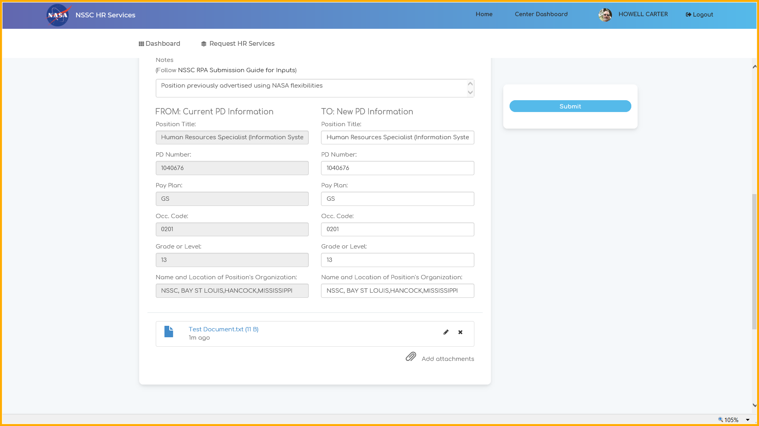
SF52 Request for Personnel Action and Approval

Slide 37
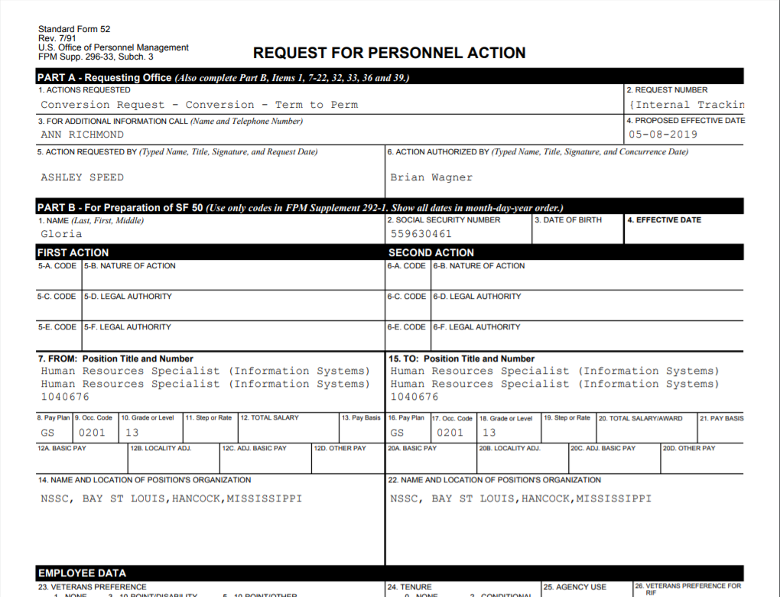
Case Approvals and SF52 documented

Slide 38

QUESTIONS
Type your questions in the chat
Any unanswered questions will be addressed in FAQs
You may also direct comments and feedback to the HC Transformation Inbox (hq-hc-transformation-feedback@mail.nasa.gov)

Slide 39
QUESTIONS AND CONCERNS. Please reach out to the following POCs if you have any questions, concerns or requests regarding this transition.
Ann Richmond
Staffing Policy Lead
NSSC Human Resources Division
Ann.E.Richmond@nasa.gov
202-358-1981
Ashley Speed
Staffing Services Branch Chief
NSSC Human Resources Division
Ashley.h.speed@nasa.gov
228-813-6094
HC Transformation Inbox
Not-for-attribution email for all HC Transformation-related inquiries (including staffing consolidation)
hq-hc-transformation-feedback@mail.nasa.gov

Slide 40

Visit the NSSC Staffing Services website for a copy of this briefing and the latest information related to Staffing Consolidation
https://www.nssc.nasa.gov/staffing

