Slide 1
WAWF Vendor Document Creation
August 2014
NASA-specific guidance in red text
Disclaimer: Should the WAWF System be updated, these instructions may no longer be fully accurate. All attempts will be made to keep this document as current as possible.

Slide 2
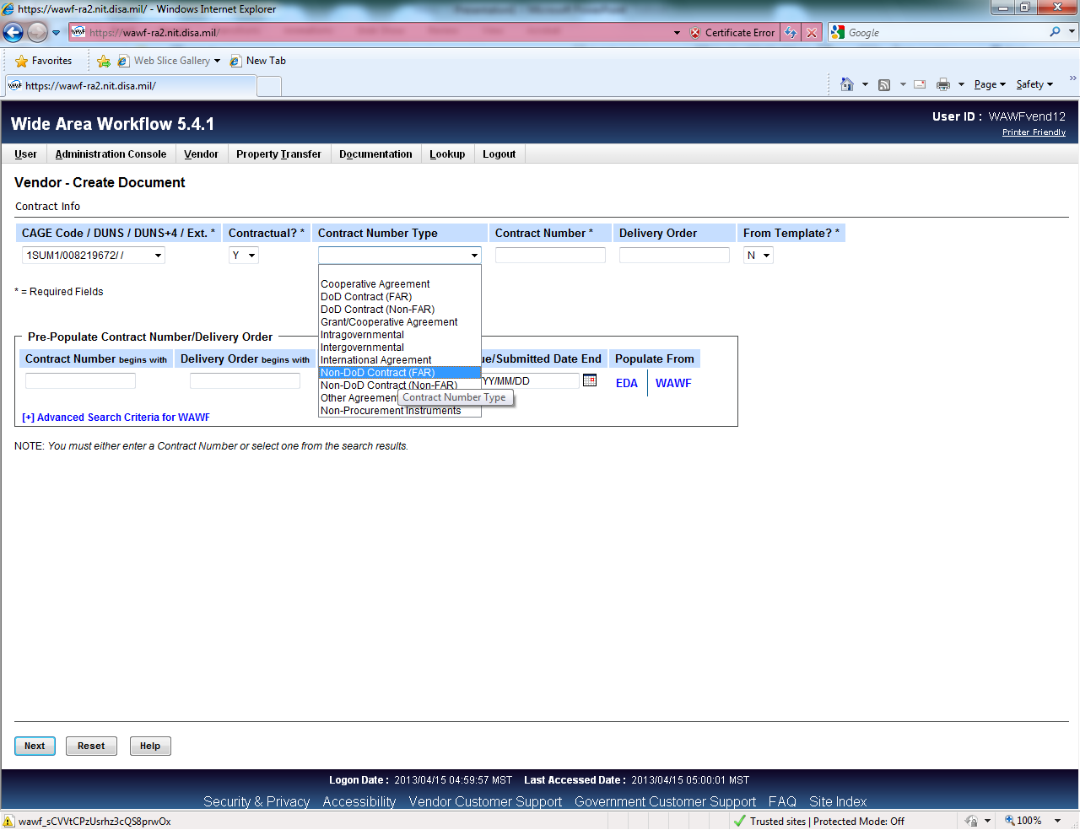
Manually Enter NN###
Do Not Click These Buttons. They will not work; no interface exists at this time.
Vendors must choose ‘Non-DoD Contract (FAR)’.

Slide 3
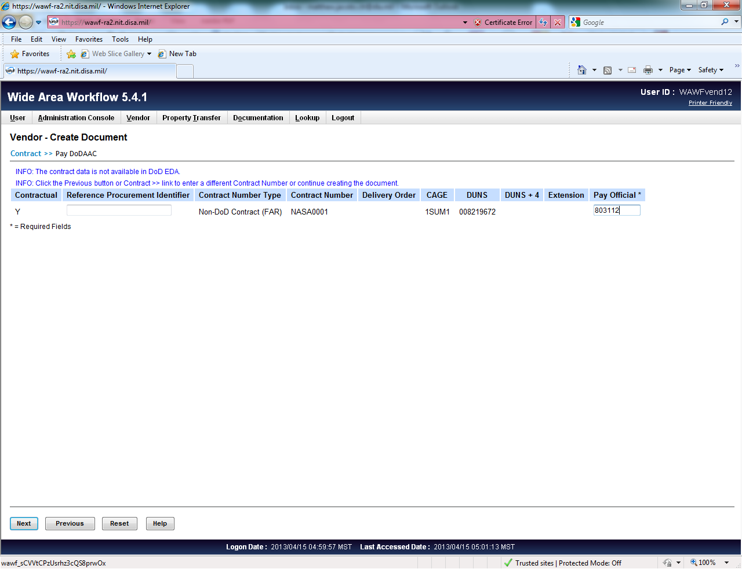
Leave blank
Vendors must enter the NASA Pay DoDAAC: 803112.

Slide 4
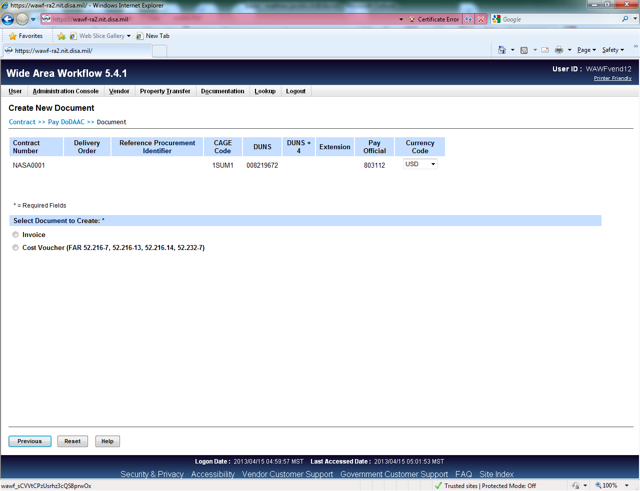
Choose a document type.
NASA Phase 1 and Phase 1A: ‘Cost Voucher’ type only.
Most DoD systems allow for more document types.

Slide 5
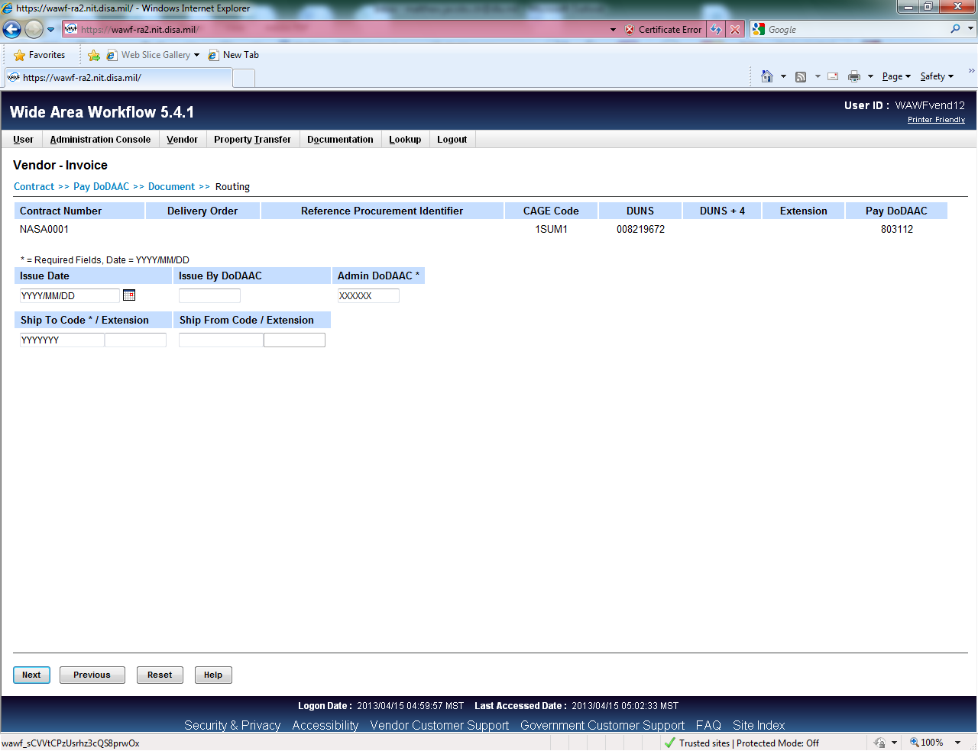
Optional
Field no longer called ‘Ship To’. Is either DCAA Auditor and/or Service Approver.
Vendors must enter the appropriate DoDAACs.
- Admin By, DCAA Auditor, and Service Approver (equivalent of Ship To DoDAAC) also all required.
NASA DoDAAC Listing can be found via this website
Go to NSSC HomePage, click For Vendors/Grantees, Vendor Payment Information, ‘E-Invoicing Web Page’ link, then see ‘DoDAAC for Vendors’ link in Vendor Support section.

Slide 6
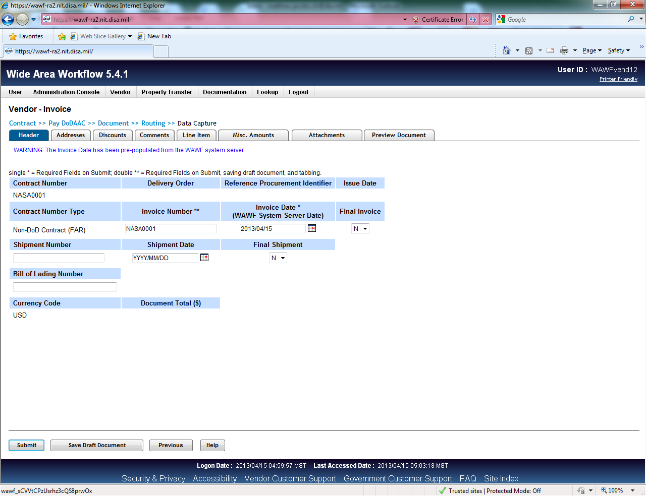
Notes:
Invoice Number must be 2-22 characters (i.e. “06”, not “6”)
Dates: YYYY/MM/DD
Address Tab auto populates from DoDAACs entered previously.
Discounts Tab: none required, but where you would put NT15/NT30/etc.
Comments: open text, not mandatory
Line Item Tab: Ignore AAI. See next slide.

Slide 7
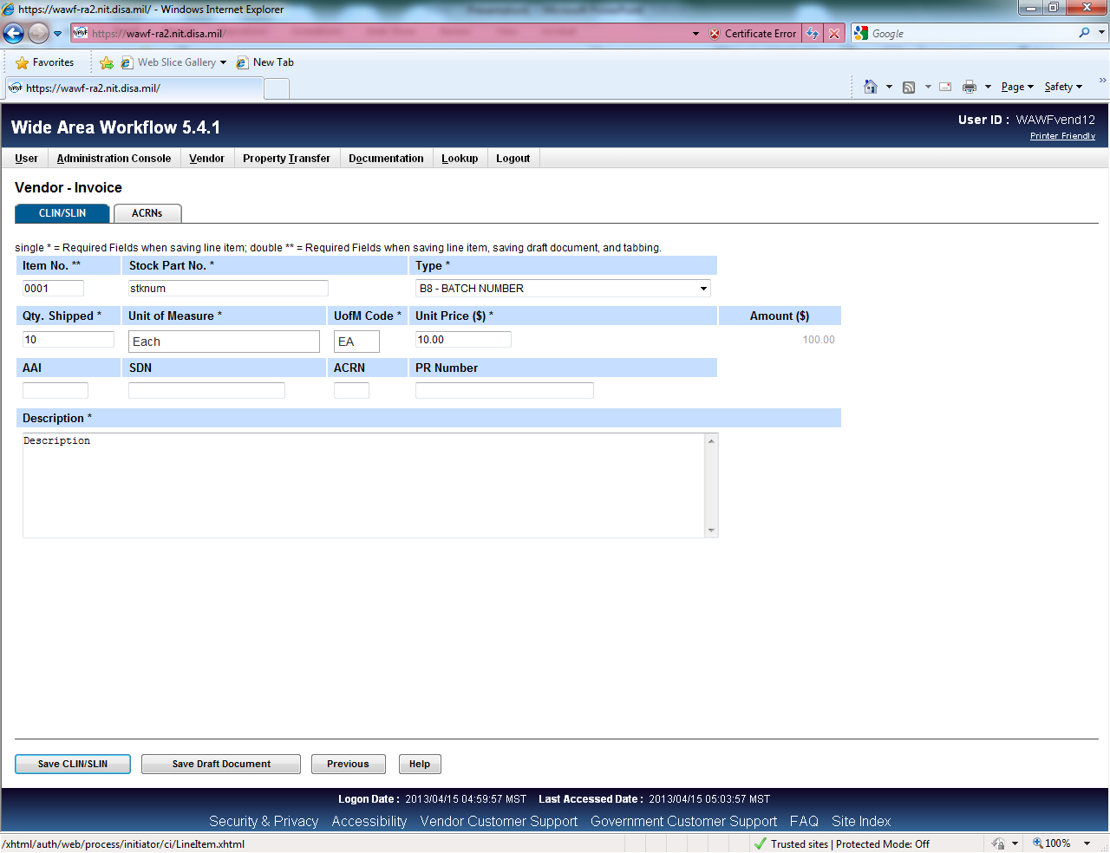
Notes:
Line Item Tab: Ignore AAI.
CLIN/SLIN Tab: Far right, click “add”.
Create Item #
Stock Number: enter “na”, if not applicable.
Type: Services is an option.
Unit of Measure: type dollars, and will auto-fill.
Skip AAI, SDN, ACRN, PR Number, unless applicable to vendor.
Description is required (i.e. Labor Cost Voucher #3 for date-date).
Click Save CLIN/SLIN.

Slide 8
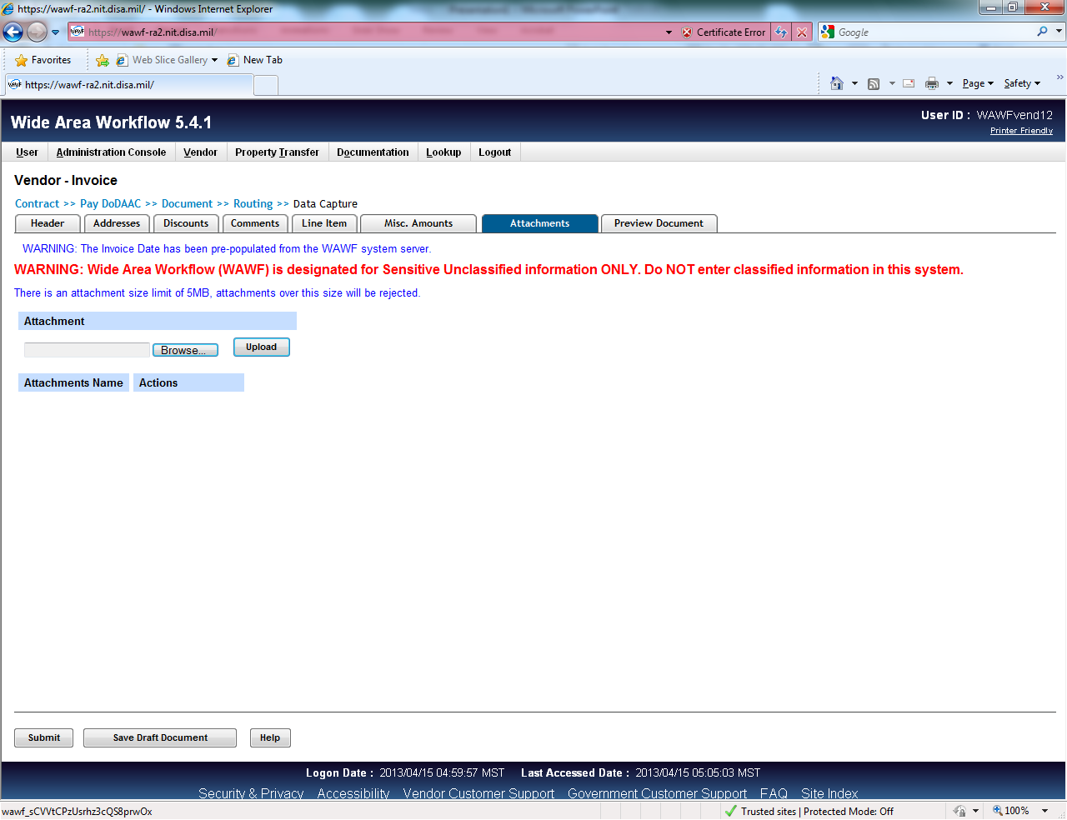
Notes:
Misc. Amounts tab (not mandatory), for Fees/Taxes
Vendors may add attachments by going to the attachments tab and selecting the ‘browse’ button to search for documents on their machine.
*File names cannot include hyphens or special characters.
*System may, or may not, accept file names with spaces in them; suggest using underscores.

Slide 9
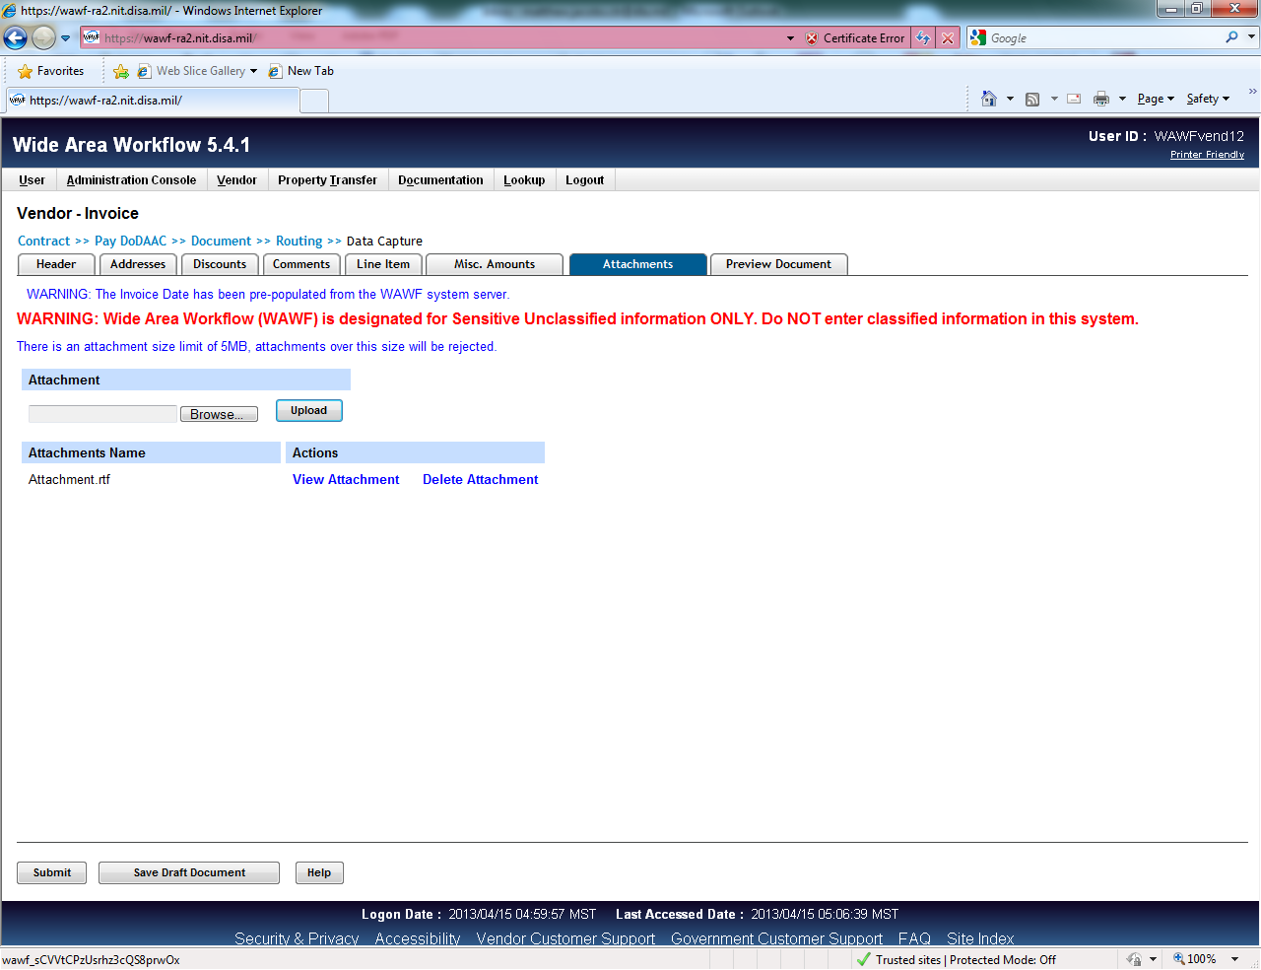
After the attachment is uploaded, it may be viewed by the vendor or removed if it is not correct

Slide 10
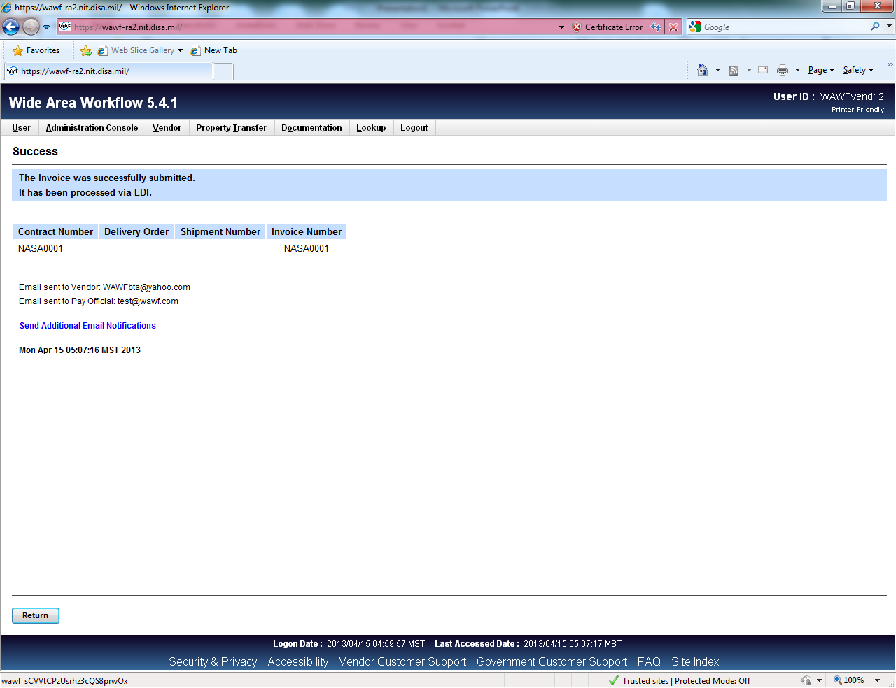
Upon submission of the document, emails are sent to the appropriate organizational email addresses
- Based on vendor’s registration info
Vendors may also send additional notification emails
Manual entry of address one time; is then stored in an ‘address book’ for future, easy use. (see next screen)
Recommend sending notification to CO and/or COR, as an FYI.

Slide 11
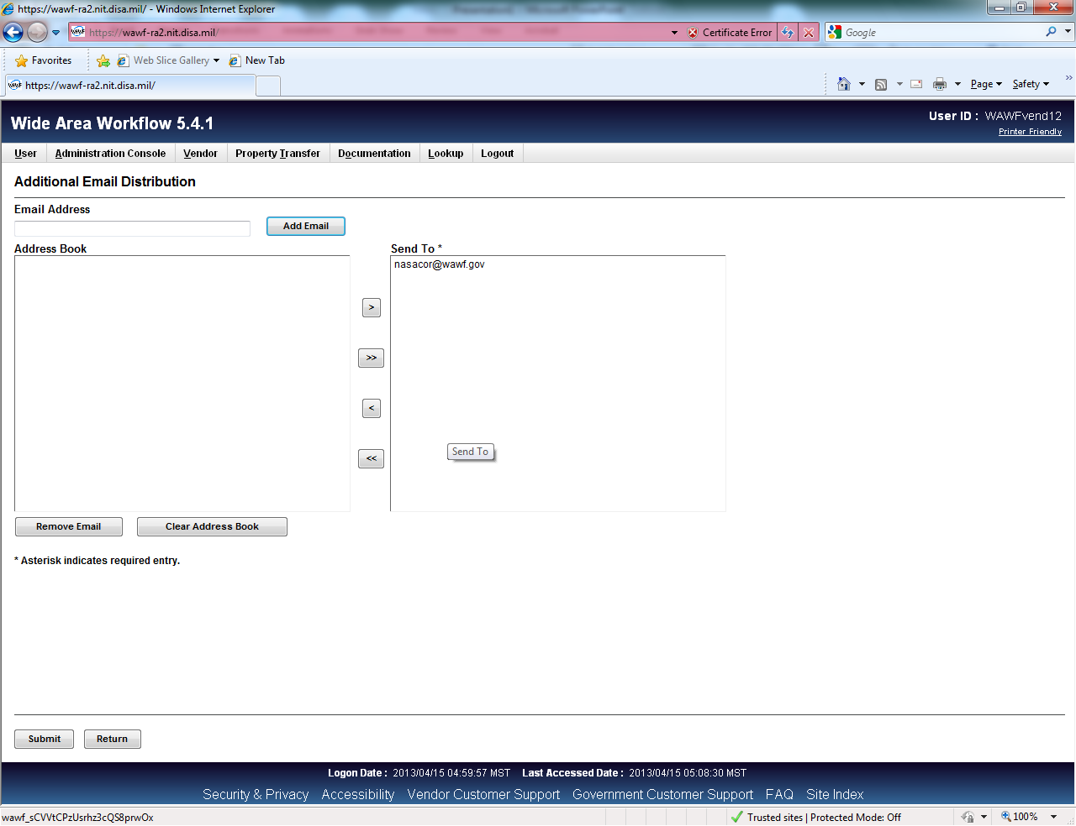
User selects the appropriate email and adds to the send to column and submits

Slide 12
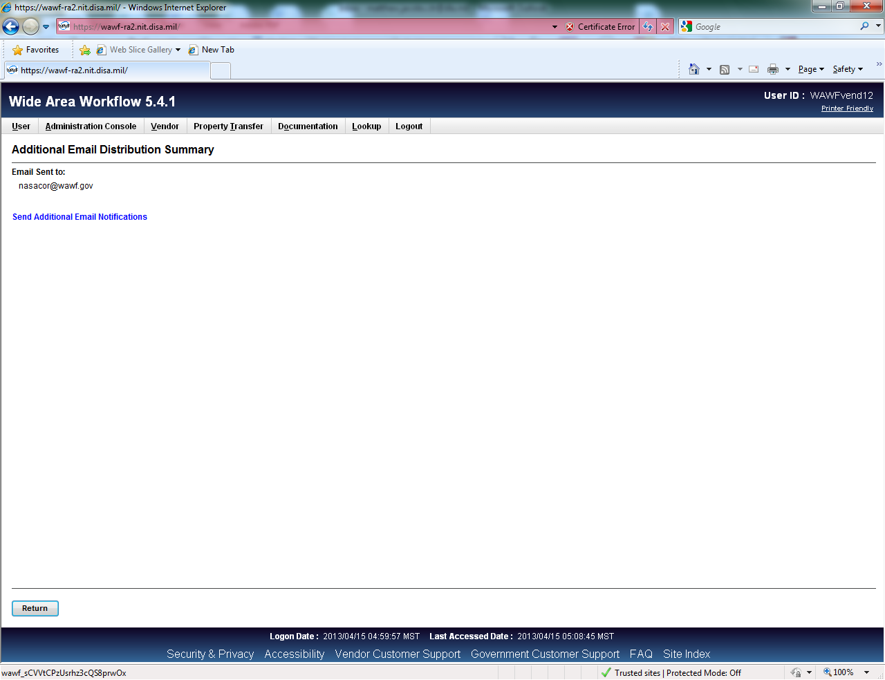
Additional email is sent

